Slide 1
Introduction to FMD
Implementing the EU Falsified Medicines Directive in the UK
[NAME OF PRESENTER]
[TITLE OF PRESENTER]
[COMPANY NAME]
Notes:
A slide deck that sets out the background to EU Directive on Falsified Medicines [2011/62/EU] and Delegated Regulation [2016/161], timelines, what’s involved and who needs to take action
[Last updated 8th December 2017]
CHANGE NAMES AND DATES AS REQUIRED

Slide 2

Falsified medicines – a real problem
The Pharmaceutical Journal, 5th June 2014
Notes:
You may recall this image from The Pharmaceutical Journal. Pharmaceutical products are very attractive to counterfeiters and others seeking illegal incomes. They are small, light, high-value and in high demand everywhere. The FBI has even estimated that trading in illegal and falsified pharmaceuticals gives better returns than dealing in narcotics, fake credit cards or pirated software.
Source: http://www.pharmaceutical-journal.com/news-and-analysis/features/taking-stock-of-counterfeit-medicines/11138907.article

Slide 3
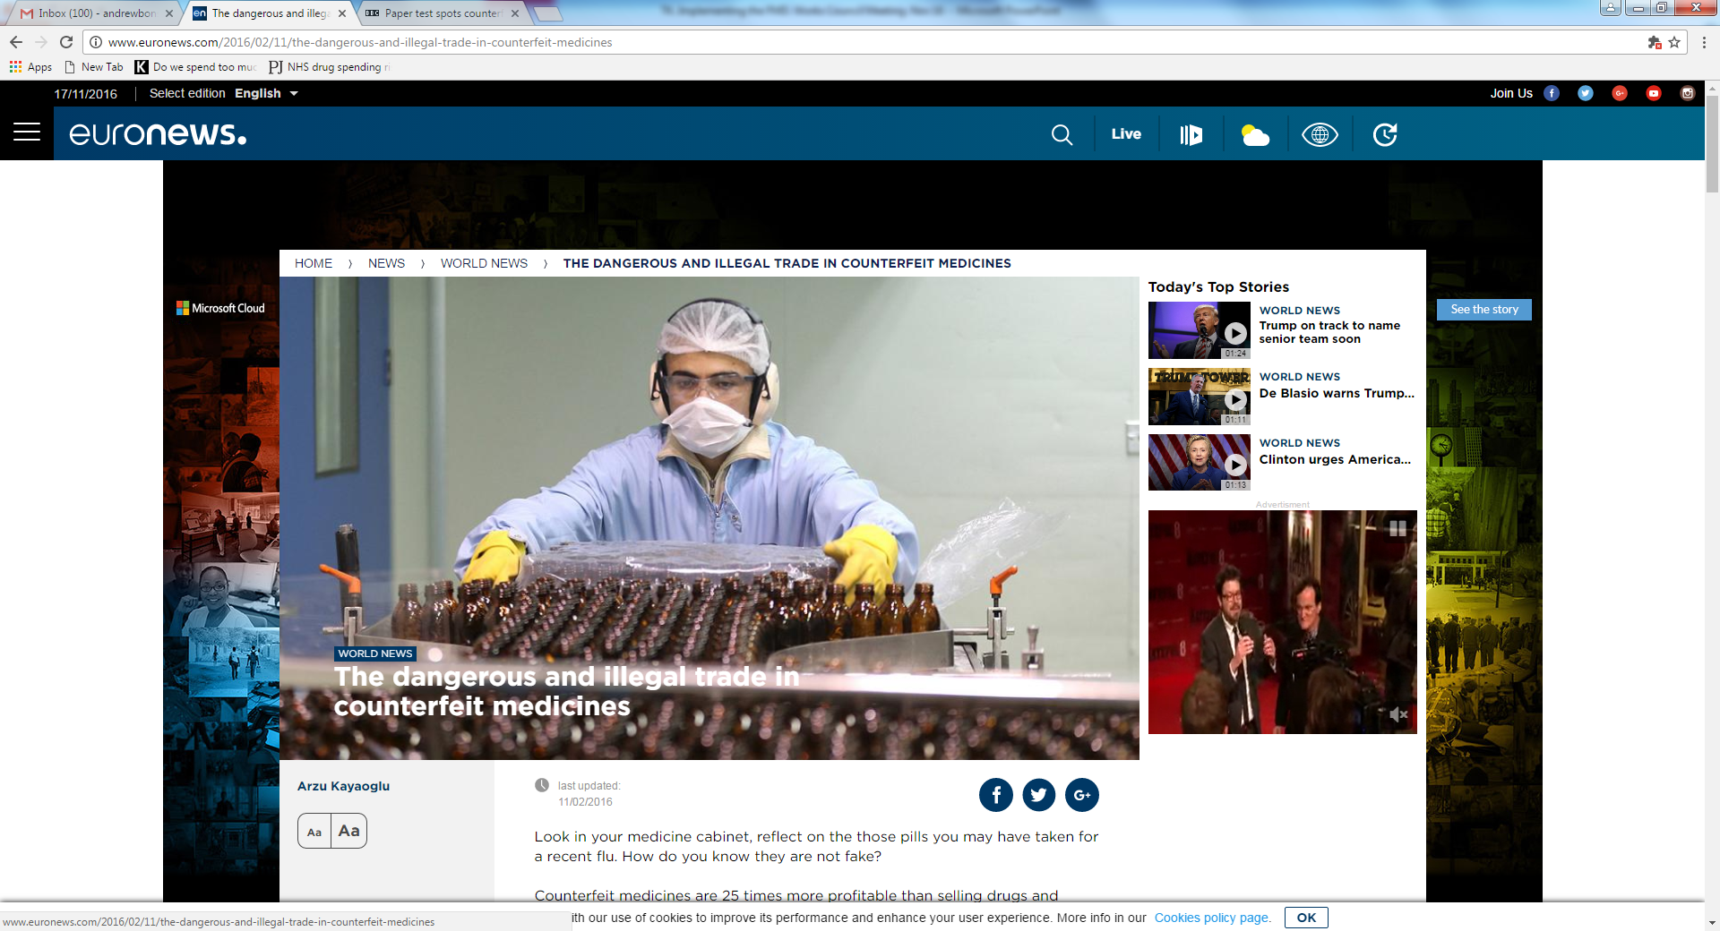
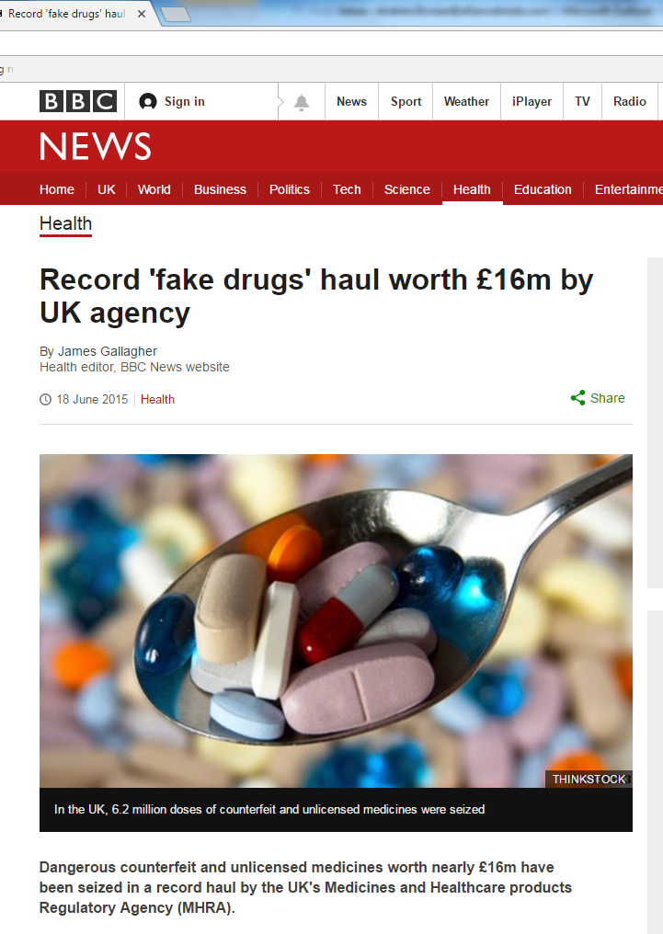
Why we need a Directive
Falsified products still being found in legitimate medicines supply chain – major risk to patient safety
Failure to address falsification could put trust in our entire industry at risk
Up to half of medicines purchased online believed to be falsified – action taken to improve security of legitimate internet pharmacies
Stronger controls now over raw materials and products manufactured under contract outside EU
Notes:
Although most sales of illegal and/or counterfeit (falsified) medicines now take place through the internet, falsified products continue to turn up in the legitimate supply chain across Europe. These have included branded products, generic medicines, non-prescription medicines, medical devices and even medicines that haven’t finished their clinical trials.
At best, these products are just unauthorised versions of the real thing. At worst they can contain little or no active ingredients, the wrong ingredients or harmful substances used as bulking or colouring agents. All of these pose a major risk to patient safety, as well as undermining confidence in our whole industry.
Discussions on FMD tend to concentrate on “scanning and verification” (which we’ll discuss in depth shortly) but the Directive also includes requirements to improve the security of legitimate online pharmacies, and much stronger controls over active ingredients, excipients and finished products that are manufactured under contract outside the EU for eventual sale in Member States.
Incidents of falsified medicines continue to be reported to National Authorities through their alerting systems.

Slide 4
FMD overview and timeline

Slide 5
Falsified Medicines – what’s the solution?
“Safety features should allow verification of the authenticity and identification of individual packs, and provide evidence of tampering.”
Directive 2011/62/EU, Para 11
All packs of almost all prescription medicines will have to have two safety features:
  Visual tamper-evident seals or packaging
  Unique identifiers (serial numbers) in 2D barcode
Authenticity is checked in two ways:
  Visual inspection of the tamper-evident features
  Scanning and checking unique identifiers against databases (“repositories”) at EU and national levels
Notes:
Authentication is always a two-step process – visual inspection and scanning of barcodes for checking against data held in national repositories.
This “bookend” solution requires manufacturers to code all products and upload data to the repositories. Pharmacies (and other dispensers) and, in some cases, wholesalers then verify packs against the codes held in the central databases, which are synchronised across Europe. This system is designed to authenticate products just before they are given to patients – it is not a “track-and-trace” system and it does not keep records of where each and every product is as it moves through the system.
Similar coding or serialisation systems are being introduced in other developed markets across the globe.

Slide 6

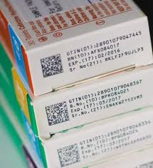
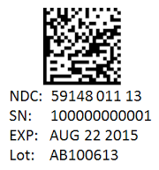
FMD and safety features
Anti-tampering device
Safety features
Unique Identifier
“Medicinal products subject to prescription shall bear safety features on their packaging”
FMD Delegated Regulation 2016/161, Article 2
Notes:
The FMD Delegated Regulation sets clear requirements for the 2D data matrix and accompanying information – based on widely used ISO standards – but there is much less guidance on anti-tamper devices.
The nature of the anti-tamper device will vary according to the product and the packaging it is contained in. Common examples are:
Packs that have ends glued shut
Use of seals or tear-off strips over pack closures
Shrink-wraps over packs and bottle necks
Closures or caps that have to be broken to open packs or bottles
Foil-packed products
As a result, checking the anti-tamper seal is always likely to be a manual process requiring a visual inspection.

Slide 7
FMD concept for verification
Unique Identifiers
Unique Identifiers
Manufacturers (brands or generics)
European Hub
Parallel traders
National system
National system
National system
National system
Pharmacies
Wholesalers
Wholesalers
Pharmacies
Pharmacies
Wholesalers
Pharmacies
Wholesalers
Data uploads
Data exchange
Verification
Authentication
Notes:
The FMD concept is based around manufacturers and parallel traders uploading unique product identifiers which are then distributed to relevant national medicines verification systems by the European Hub. The unique identifiers can be used by wholesalers, pharmacies and other dispensing entities when they need to verify and authenticate (dispense) medicines in their possession. The European hub can be used to synchronise pack statuses across multiple markets and to verify products from other markets, if necessary.
[“Fluffy cloud diagram”]

Slide 8
Falsified Medicines Directive (FMD) timeline
Directive 2011/62/EU adopted
First elements of Directive come in to force (APIs and excipients)
EMVO and European Hub established
EU logo for online pharmacies starts
2011
2013
2015
Delegated Regulation
2016/161
published
Set up NMVOs/
pick BSPs
Full requirements of Directive start (scanning)
End of non-2D packs (could be earlier)
FMD pilots
2016
2017
2018
2019
2024
FMD onboarding
Brexit?
Notes:
FMD is a very long running project. There was nearly a decade of discussions leading up to the formal adoption of Directive 2011/62/EU and it’ll have been more than a decade since then by the time that all medicines across Europe carry the required 2D data matrix and individual serial numbers. Scanning and verification of packs will start in early 2019 with pilot work prior to that.
Most EU/EEA countries, including the UK, have established an NMVO. Most of these have chosen their BSP (with the majority choosing Arvato) and started setting up their NMVSs. The most advanced countries, including Ireland, Germany and Sweden, are planning to start pilot phases with pharmacies and wholesalers early in 2018.

Slide 9
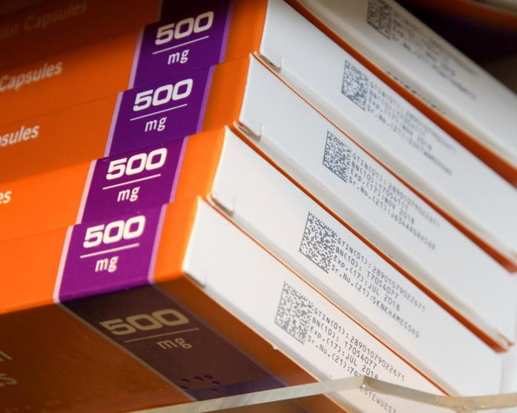
Notes:
The future is already here. These packs were found in Boots in Kingston-upon-Thames in March 2015. Many contract manufacturers are already moving towards using 2D barcodes, especially those based in India which is bringing in similar legislation requiring pack serialisation.
These packs are not fully FMD-compliant yet. The serial numbers are not uploaded to the European hub and

Slide 10
FMD Delegated Regulation – key questions answered

Slide 11
FMD – key questions answered
Who is involved?
You are
“Persons authorised or entitled to supply medicinal products to the public shall verify the safety features and decommission the unique identifier of any medicinal product bearing the safety features they supply to the public at the time of supplying it to the public.”
Delegated Regulation 2016/161, Article 25(1)
Notes:
Persons authorised or entitled to supply is Euro-speak for pharmacists (and dispensing medical practices)
At the time of supplying it to the public means “in pharmacies”
Wholesalers are not going to be doing this for you!

Slide 12
FMD – key questions answered
What is included?
Everything
“This Regulation applies to: medicinal products subject to prescription … unless included in the list set out in Annex 1; medicinal products not subject to prescription included in the list set out in Annex 2”
Delegated Regulation 2016/161, Article 2(1)
Notes:
Annex 1 – sometimes known as the “White list” is pretty short – apart from homoeopathic products, they are mostly very specialist products such as radionuclides, gases, advanced cell therapies and intravenous products that most community pharmacies never handle
Annex 2 – sometimes known as the “Black list” is even shorter – it’s currently only got two products on it and neither of them is available OTC in the UK
You are going to have to get used to scanning every pack, every time

Slide 13
FMD – key questions answered
When does it start?
Soon
“This Regulation shall enter into force on the twentieth day following that of its publication in the Official Journal of the European Union. It shall apply from 9th February 2019.”
Delegated Regulation 2016/161, Article 50
Notes:
The final version of the Delegated Regulation was published on 9th February 2016. This started a three-year countdown for all Members States, except Belgium, Italy and Greece, which already have some sort of verification system in place and which have until February 2025 to comply. Belgium has since indicated it will comply by 2019.

Slide 14
FMD – key questions answered
Will I have to pay for it?
In part
“The costs of the repositories system shall be borne by the manufacturers of medicinal products bearing the safety features.”
“The repositories system shall not include the physical scanning equipment used for reading the unique identifier.”
Draft Delegated Regulation, Articles 31(5) and 32(4)
Notes:
The manufacturers (or technically the Marketing Authorisation Holders) will have to pay for the costs of setting up the European and national repositories (databases) and for uploading the unique codes to them.
However wholesalers and pharmacists will have to pay their own costs for being able to connect to the system, including having the right barcode scanners that can read 2D data matrix barcodes and any software and network upgrades that are necessary. Whether this is a “regulatory burden” is still to be discussed with the Department of Health and the Devolved Administrations

Slide 15
FMD – key questions answered
Can we opt out?
No?
“This Regulation shall be binding in its entirety and directly applicable in all Member States.”
Delegated Regulation 2016/161, Article 50
Notes:
Parts of the FMD Directive [2011/62/EU] are already included in the UK’s Human Medicines Regulations 2012. The Delegated Regulation is automatically binding on Member States, including (for the time being) the UK.
So, you say, it’s OK – we voted to leave. I’m afraid it’s not clear yet whether that will work either. FMD is likely to start before we formally leave (under current plans, and who knows what will happen next). The four European Free Trade Area countries – Norway, Switzerland, Iceland and Liechtenstein – are participating and we may still be part of that. Anyway, not participating would make the UK “the hole in the Polo mint” and a potential dumping ground for all the substandard medicines in Europe – that’s not in the interests of patients.
Most other major pharmaceutical markets are developing serialisation as a way of reducing falsification. This means major manufacturers are unlikely to want to produce special products for the UK only once FMD really gets going.

Slide 16
FMD Delegated Regulation – what do you have to do?

Slide 17
FMD – requirements for manufacturers
Delegated Regulation requires manufacturers to:
  Put safety features (tamper-evident and unique identifier) on almost all prescription medicines
  Encode unique identifier in 2D barcode meeting certain standards
  Print 2D barcodes and certain details on all relevant packs
  Upload unique identifiers into repositories system (consisting of European hub and national repositories)
  Set up and pay for the repositories system via non-profit legal entities
  Report any suspected incidents of tampering or falsification
  Decommission certain products
  Notify repositories of any recalled, withdrawn or stolen products

Slide 18
FMD – requirements for wholesalers
Delegated Regulation requires wholesalers to:
  Verify authenticity of any returns and products not bought directly from manufacturers or their contracted distributors
  Decommission identifiers of products being exported, withdrawn, destroyed or taken as samples
  Decommission products being supplied to public by other routes (ie, not via pharmacy, dispensing doctors or hospitals)
  Not distribute or supply decommissioned products (other than those they are required to decommission for others)
  Notify authorities of any suspected incidents of tampering or falsification
  [Note: also applies to pharmacies who hold wholesale licences]

Slide 19
FMD – requirements for pharmacies
Delegated Regulation requires pharmacies to:
  Verify the authenticity of products (checking tamper-evident and unique identifiers) and then decommission identifiers “at the time of supplying it to the public”
  Only be able to revert decommissioned products (undispense) within 10 days of the original dispensing
  Decommission products that cannot be returned to wholesalers or manufacturers or which are taken as samples
  Not to supply decommissioned products (other than those they decommission themselves as part of dispensing)
  If technical problems prevent authentication, to record unique identifiers and then verify and decommission when possible
  Notify authorities of any suspected incidents of tampering or falsification

Slide 20
The journey of a patient pack

Slide 21
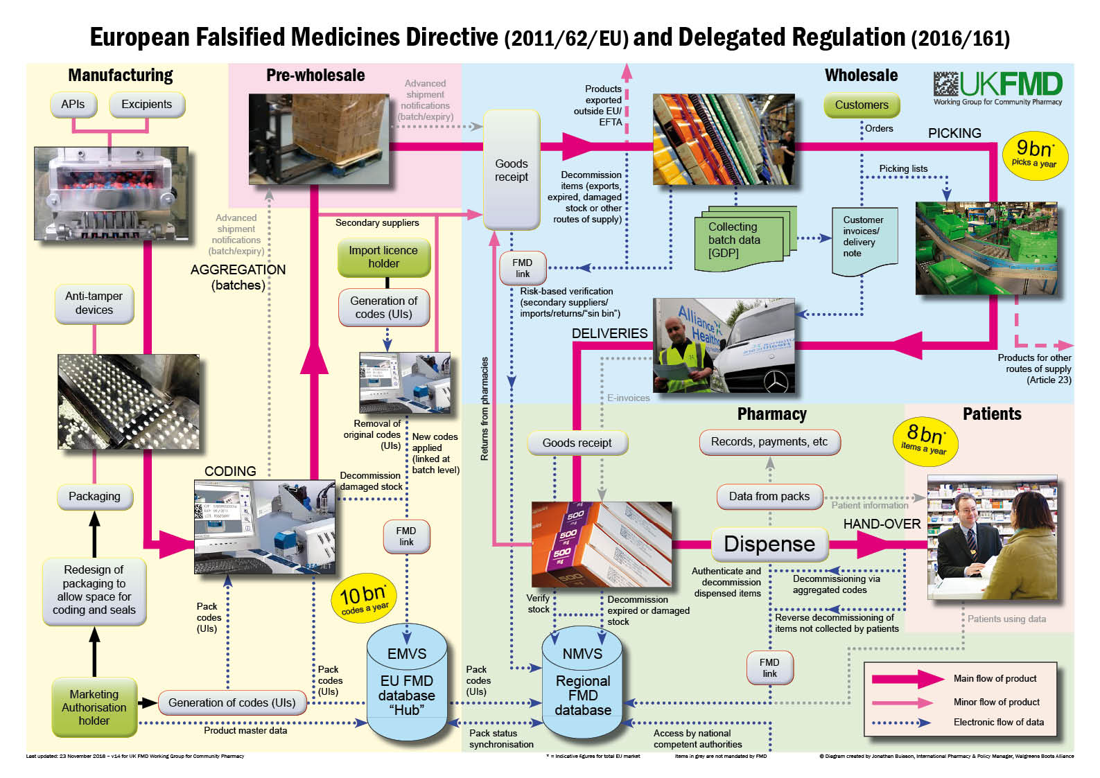
Notes:
The “FMD big chart” – our work has given us a detailed understanding of the main flow of products (pink lines) and where data will be exchanged between companies and with the central and national databases (blue dotted lines). There are some data exchanges (grey lines) that we anticipate will, might or could happen in future, but these are not mandated by the Directive.

Slide 22
Potential benefits from FMD

Slide 23
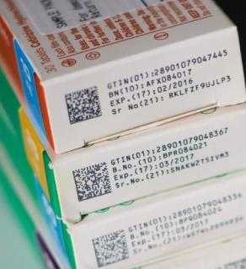
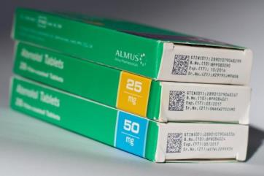
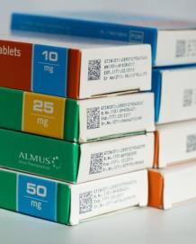
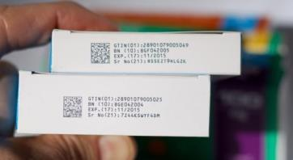
Notes:
Every pack will have to have a unique identifier (coded in to the 2D data matrix on the barcode). This will contain all the details about the pack, the product, its size and strength, as well as batch and expiry date and a serial number unique to that particular pack. This is much more detailed than the information held in the linear barcodes that we are used to.

Slide 24

FMD – potential benefits
Patient safety benefits
Accuracy and date checking made easier
Pharmacy stock benefits
Accurate pack-level data for all products
Patient information benefits
Able to generate
patient-specific information
Notes:
We all know that FMD is going to be difficult and costly to implement and it affects all parts of the medicines supply chain. So what are the potential benefits, apart from reducing the risk of falsified medicines reaching patients?
Most of these boil down to the fact that each pack will have a much greater level of machine-readable data encoded on it, including full product details, batch data and expiry dates. As we are going to have to scan pretty much “every pack, every time”, this deep source of data can be used to enhance processes that currently involve a lot of manual data entry, or where a more detailed link to a specific pack will be helpful.
Accuracy checking and date checking of stock should be much easier to automate once both pack data and prescription data are all electronic or scannable. This data should also allow pharmacies to have more accurate stock files and better re-ordering. There are also possibilities for generating patient-specific information that can help boost customer loyalty and adherence.

Slide 25
Implementing FMD

Slide 26
Implementing FMD – what needs to happen?
National Medicines Verification System to be set up
Pilot verification systems in pharmacies, wholesalers, hospitals
Integrate FMD verification software with existing systems
Upgrade hardware (scanners) and IT connections
Develop processes for authentication in day-to-day practice
Develop procedures to deal with offline and “fail to authenticate”
Establish governance, inspection and enforcement rules
Explain to all in supply chain why, what and when of FMD
Explain to public and media why, what and when
Go live (2019) then iterate/develop
… and lots, lots more
Notes:
Lots to do and not that much time to do it, for a major IT-based project that will become business-critical for the entire medicines supply chain

Slide 27

Implementing FMD – time for action is now
The clock is already ticking!
Notes:
FMD will have to be implemented by February 2019, which means everyone will have to be largely ready for it before the Christmas rush starts at the end of 2018.
The time for talking is coming to an end – the time for action is now

Slide 28
Questions and discussion

Slide 29
For further details and updates:
Jonathan Buisson MFRPSII MRPharmS
FMD Communications Lead
UK FMD Working Group for Community Pharmacy
(jonathan.buisson@WBA.com)
Notes:
For any further information or updates, please contact Jonathan Buisson, FMD Communications Lead for UK FMD Working Group for Community Pharmacy

