Slide 1
Scanning packs – what to look for
Implementing the EU Falsified Medicines Directive in the UK
[NAME OF PRESENTER]
[TITLE OF PRESENTER]
[COMPANY NAME]
Notes:
A slide deck illustrating the “right” and “wrong” types of medicines packs to be scanned under EU Directive on Falsified Medicines [2011/62/EU] and Delegated Regulation [2016/161]
[Last updated 13th November]
CHANGE NAMES AND DATES AS REQUIRED
TO BE UPDATED WITH FURTHER EXAMPLES AS NECESSARY

Slide 2
FMD – what the “right” packs look like

Slide 3
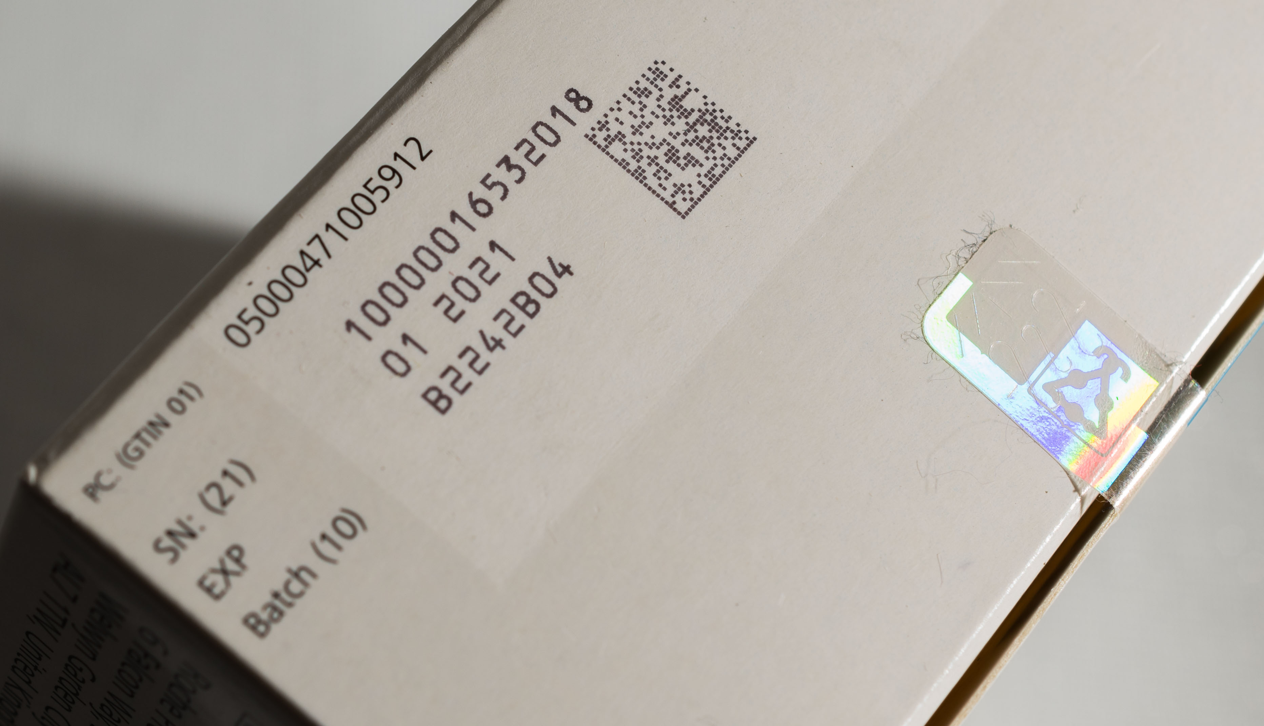
FMD safety features – what to look for
2D data matrix
[printed on low-reflecting area]
Anti-tampering device
[various different kinds can be used]
Human-readable text
[Product code or GTIN – may be pre-printed]
[Serial number] [Expiry date] [Batch or lot number]

Slide 4
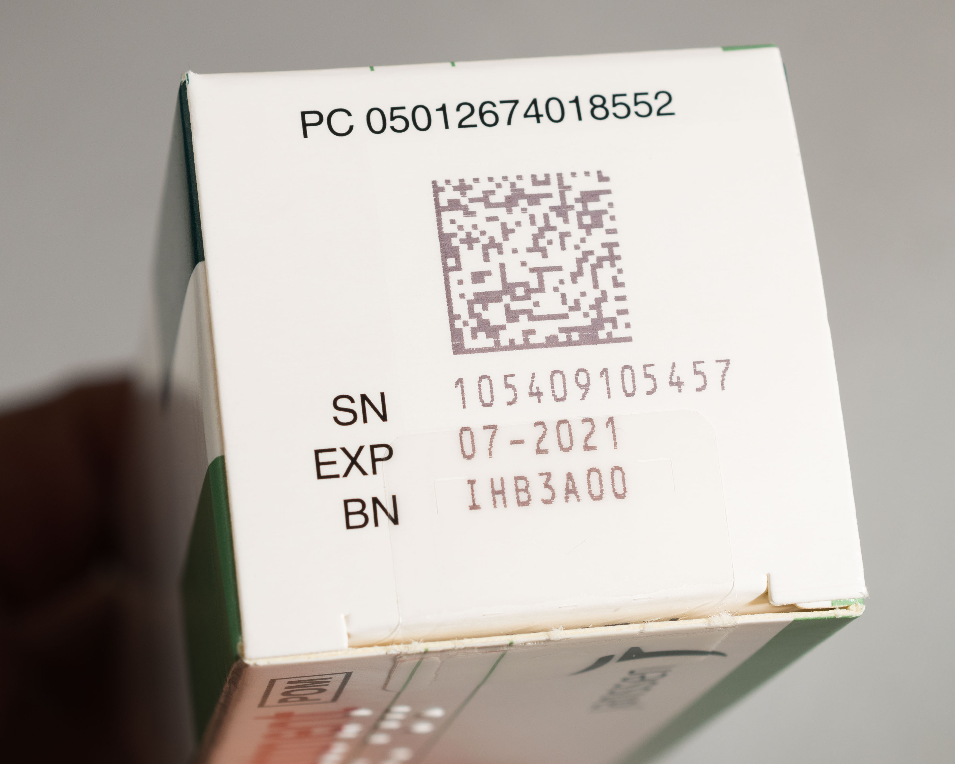
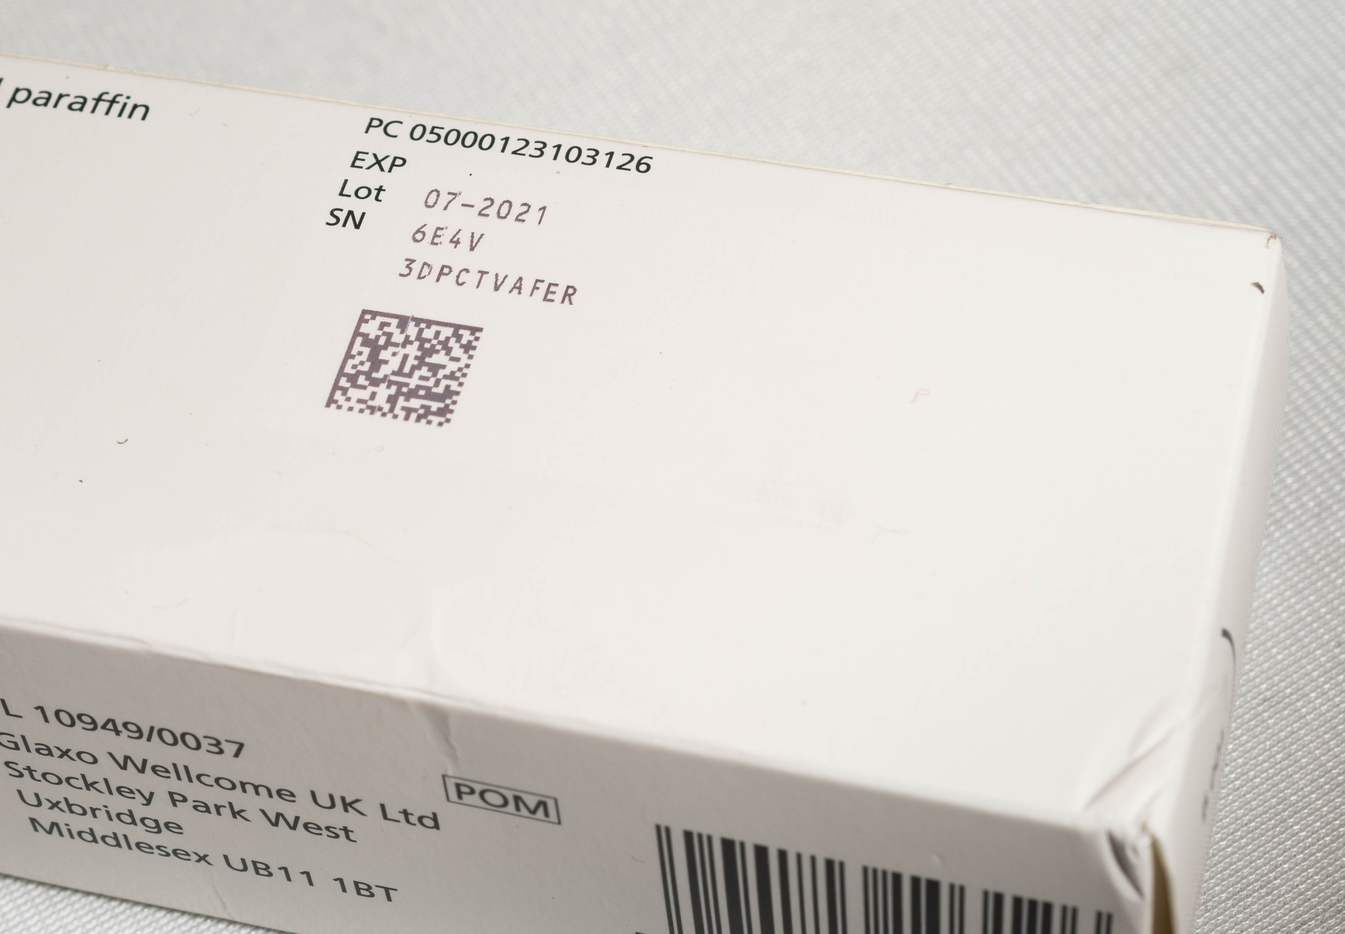
FMD safety features – 2D data matrix
Normally on end of pack
Normally next to human-readable text items
Only one 2D data matrix
allowed on each pack
Sometimes printed on
different part of pack

Slide 5
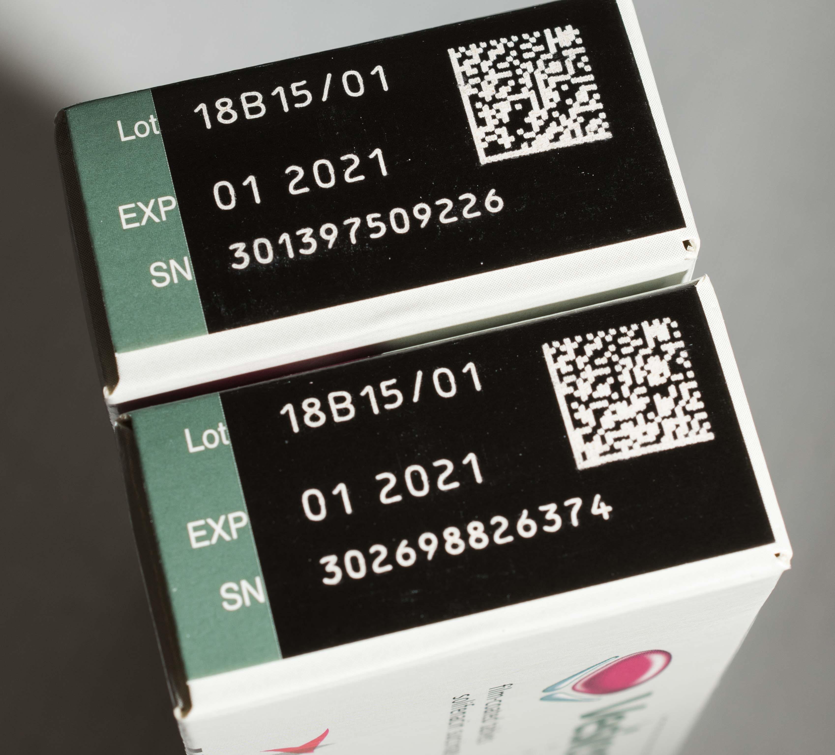
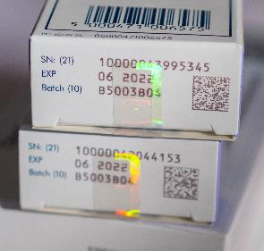
FMD safety features – 2D data matrix
Can be printed in reverse
(white-on-black/colour)
Scanners need to be set
to recognise this format
Seals or stickers should not
obscure 2D matrix

Slide 6
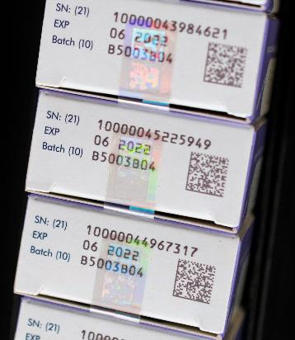
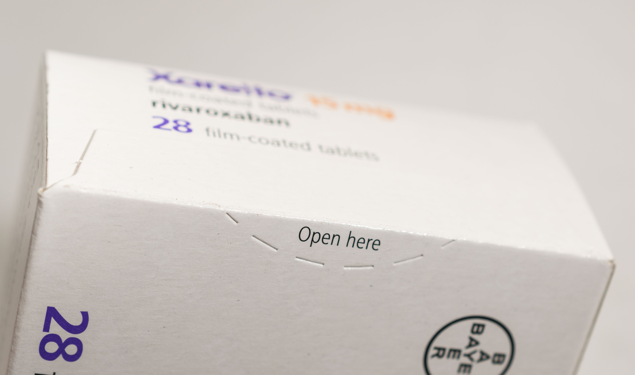

Examples of anti-tampering devices
Pack glued shut
[with perforations]
Twist to open
[with device visible]
Seals or stickers
[with or without holograms]

Slide 7
FMD – what the “wrong” packs look like

Slide 8
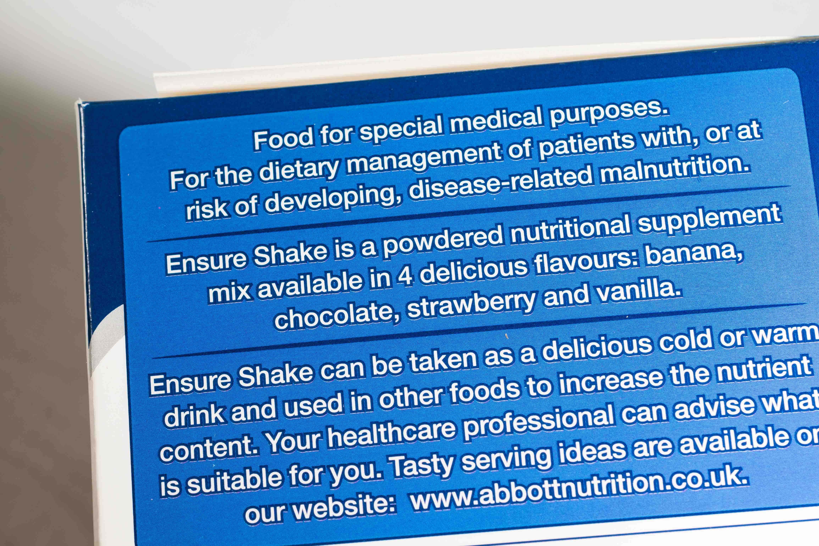
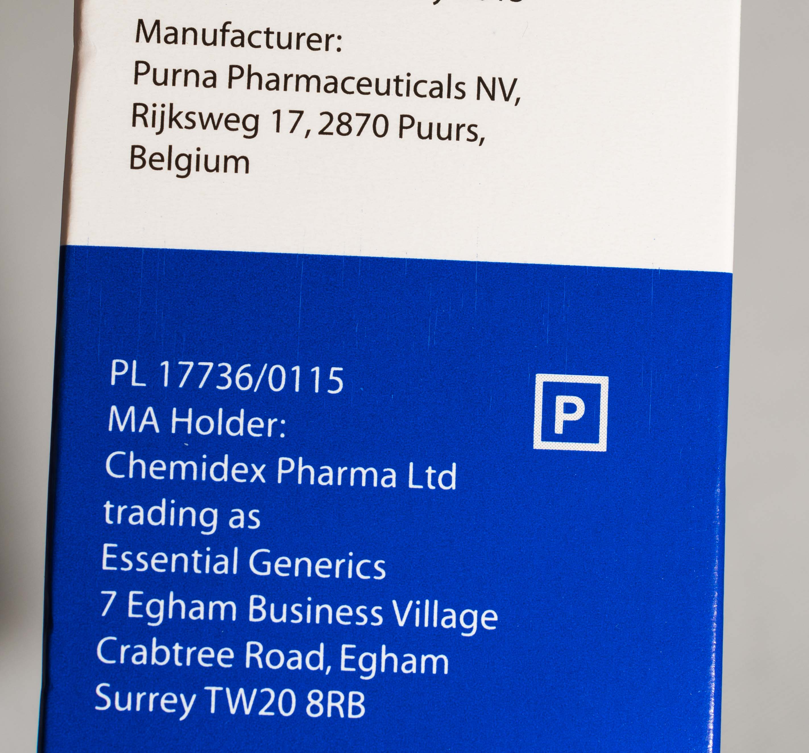
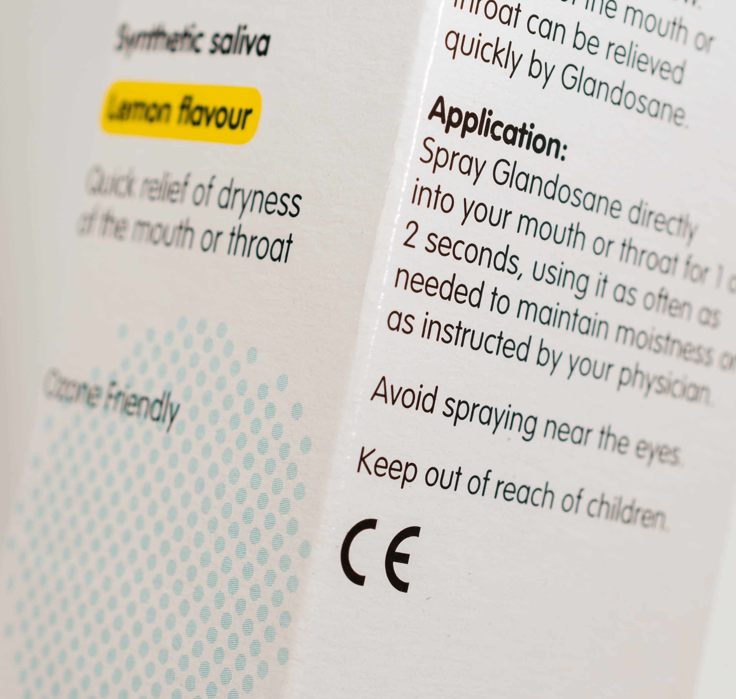
Out-of-scope – do not need to be authenticated
Not a medicine
[Specialist foodstuffs]
Medical device
[with CE marking]
Non-prescription
[Pharmacy (P)]
[General Sale List (GSL)]

Slide 9
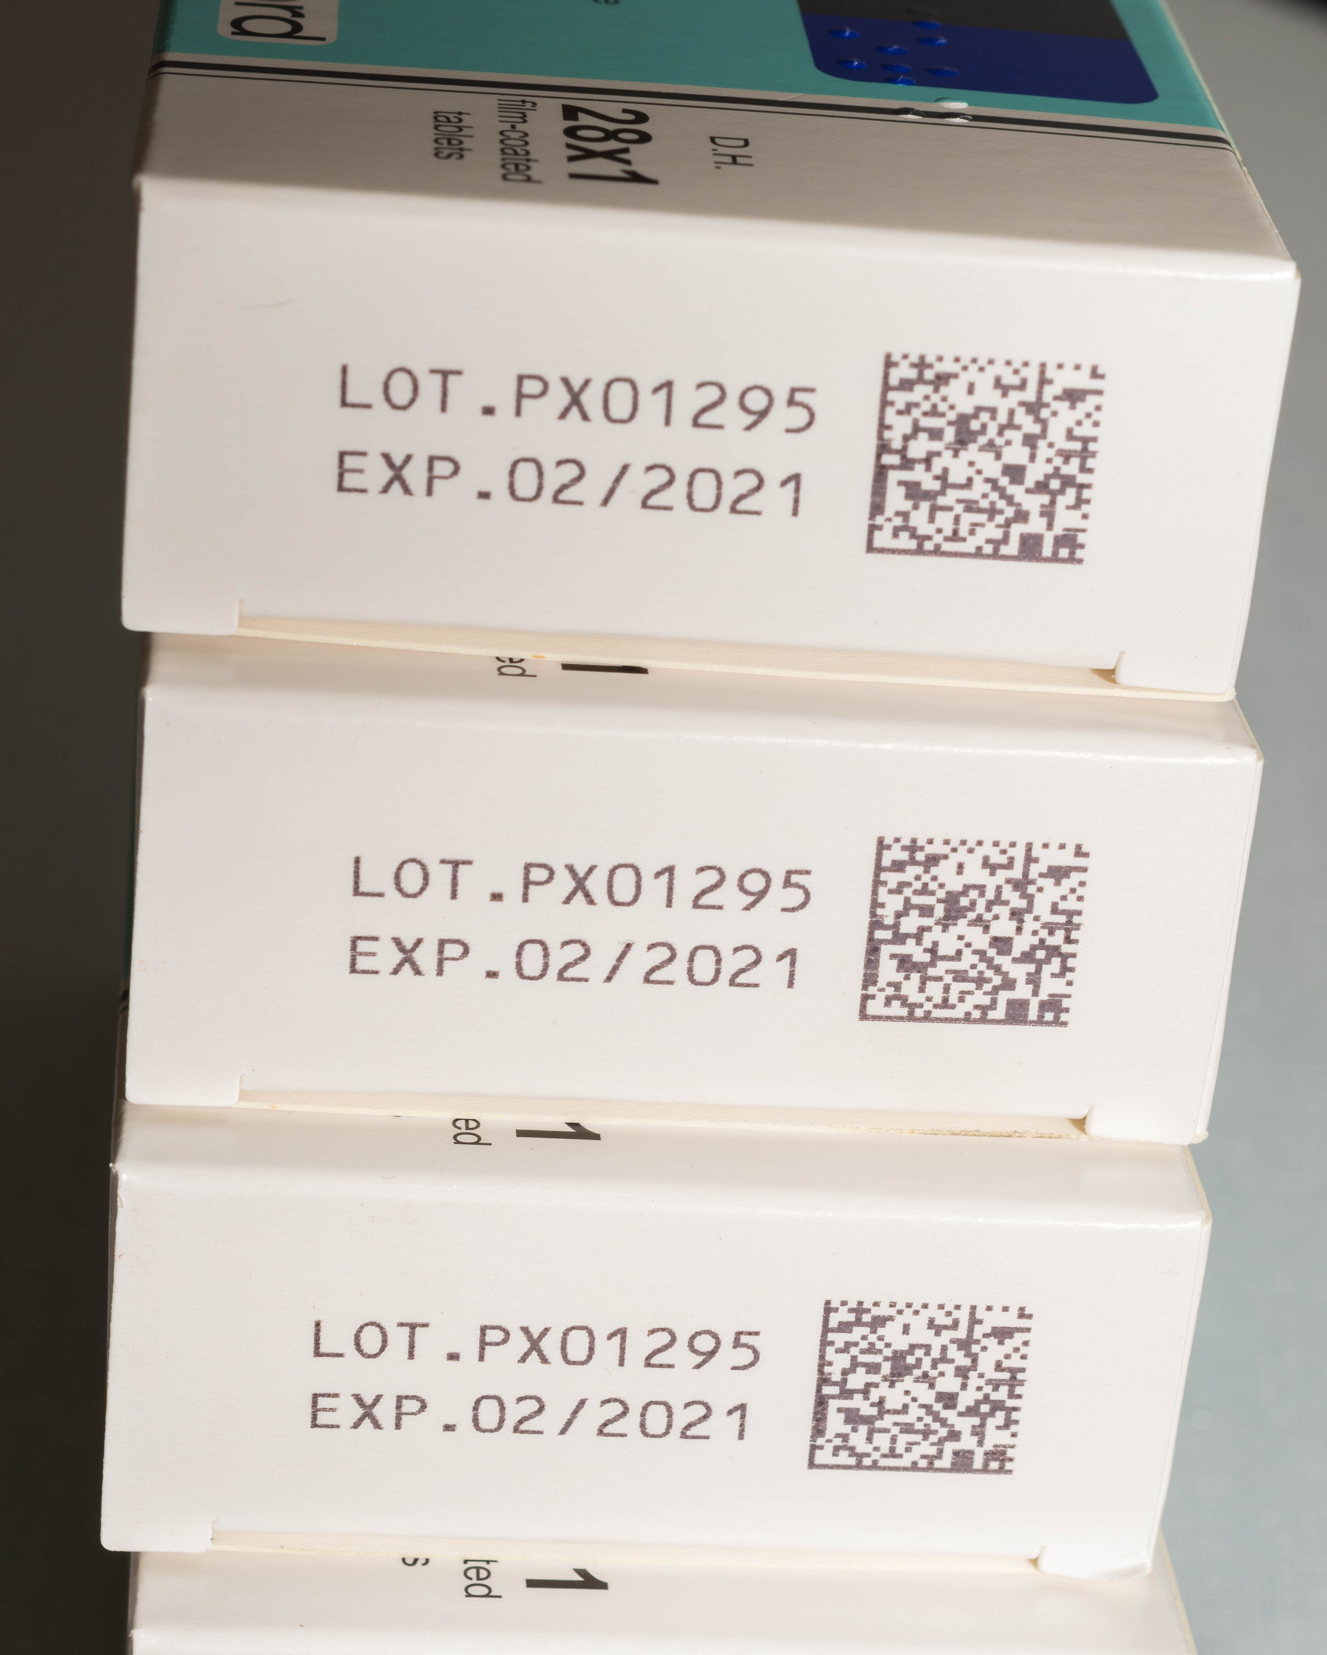
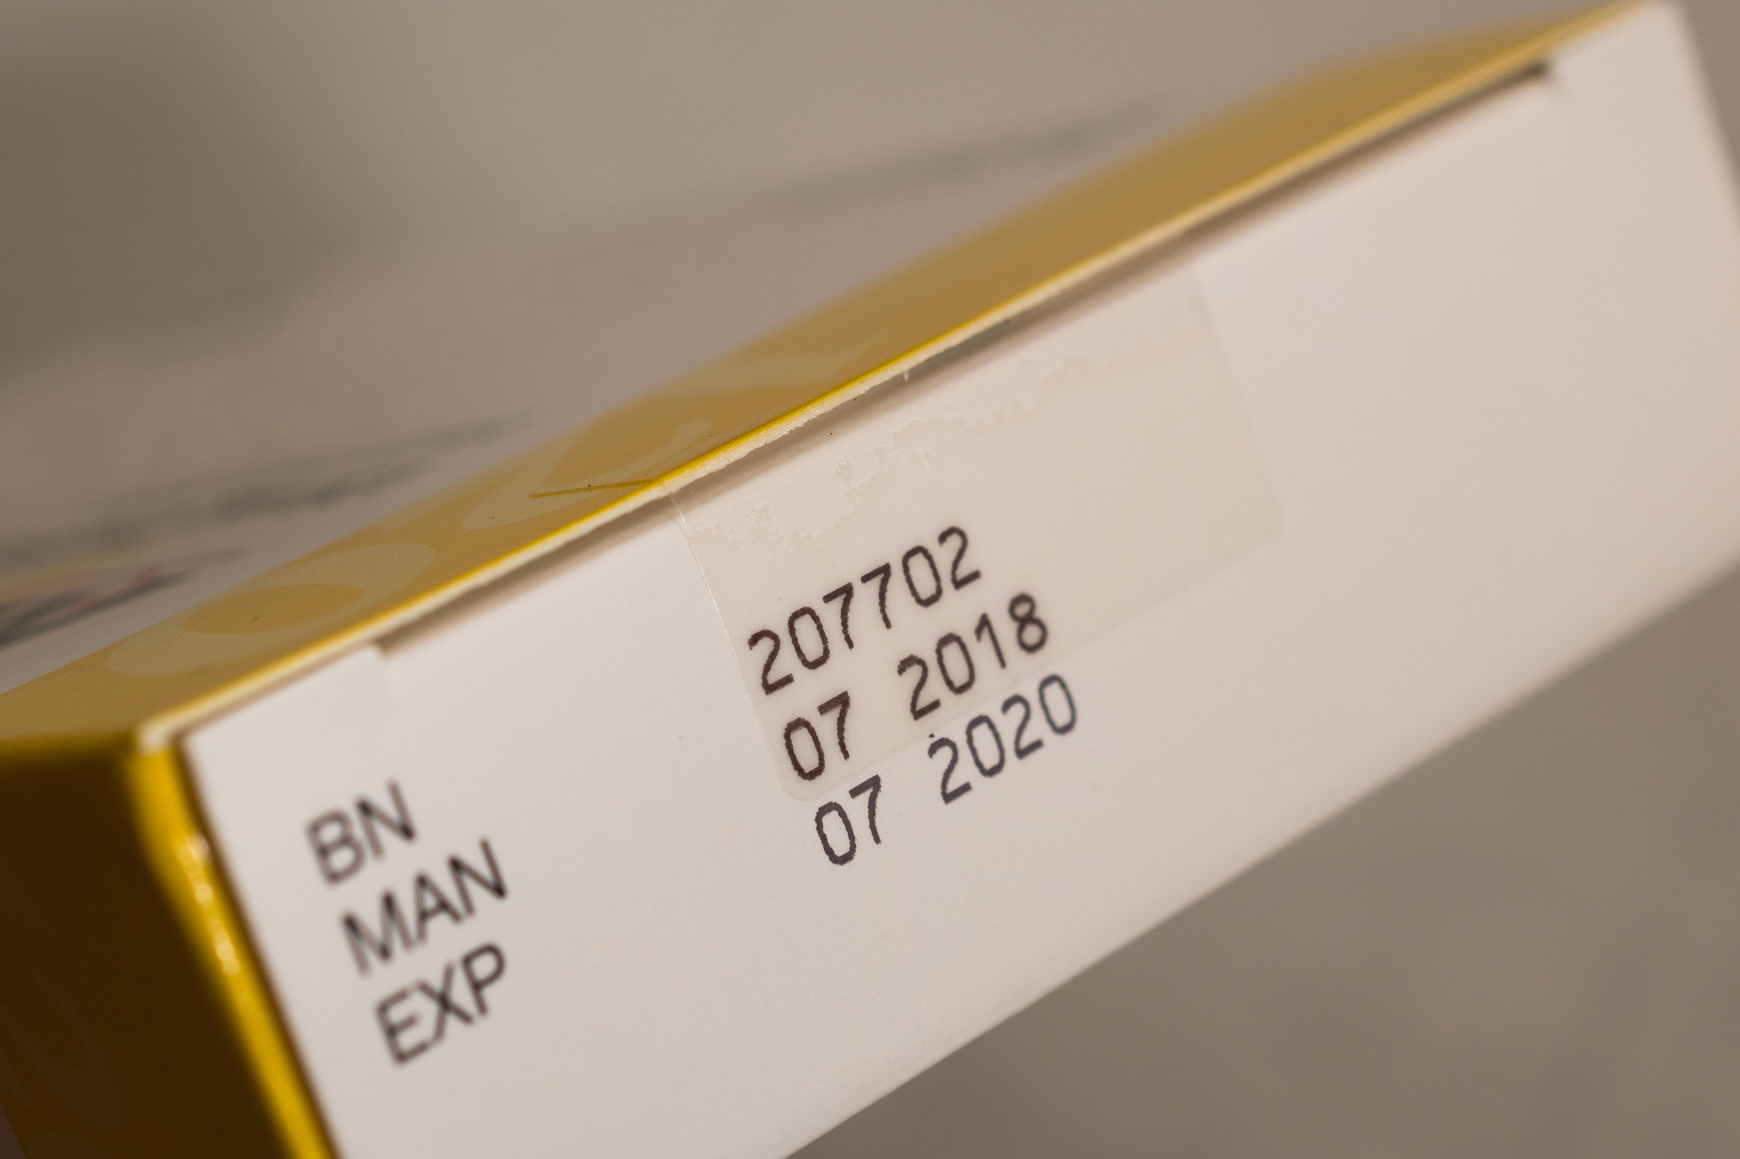
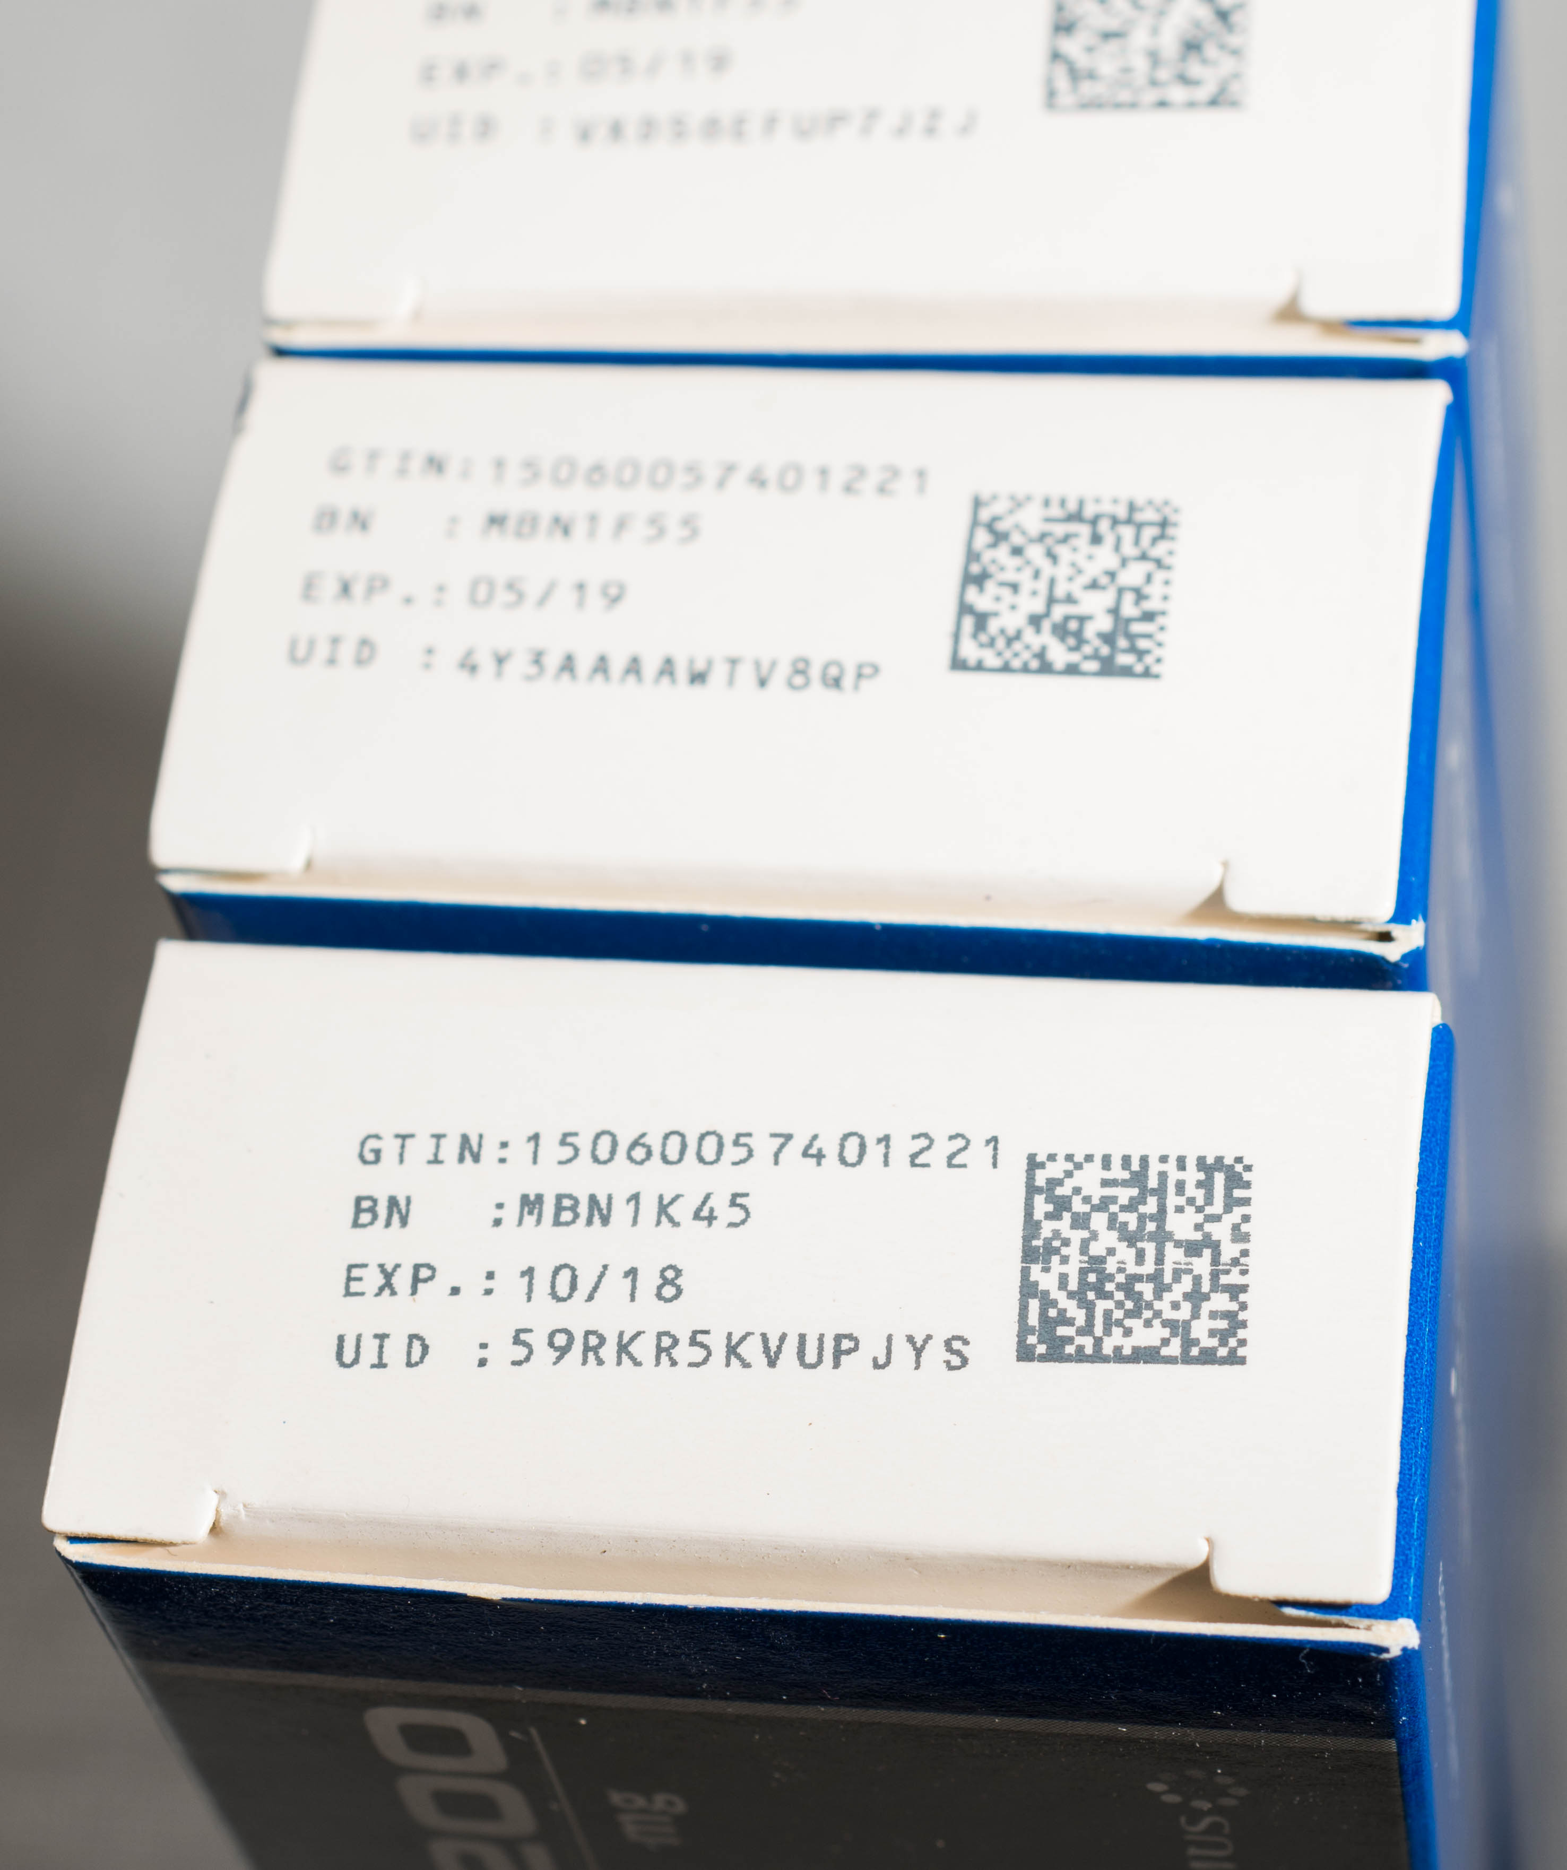
Older stock (without safety features) can still be used
No serial number
[with or without 2D data matrix]
No anti-tampering device
[with or without 2D data matrix and serialisation]
No 2D data matrix
[with or without anti-tampering devices]

Slide 10
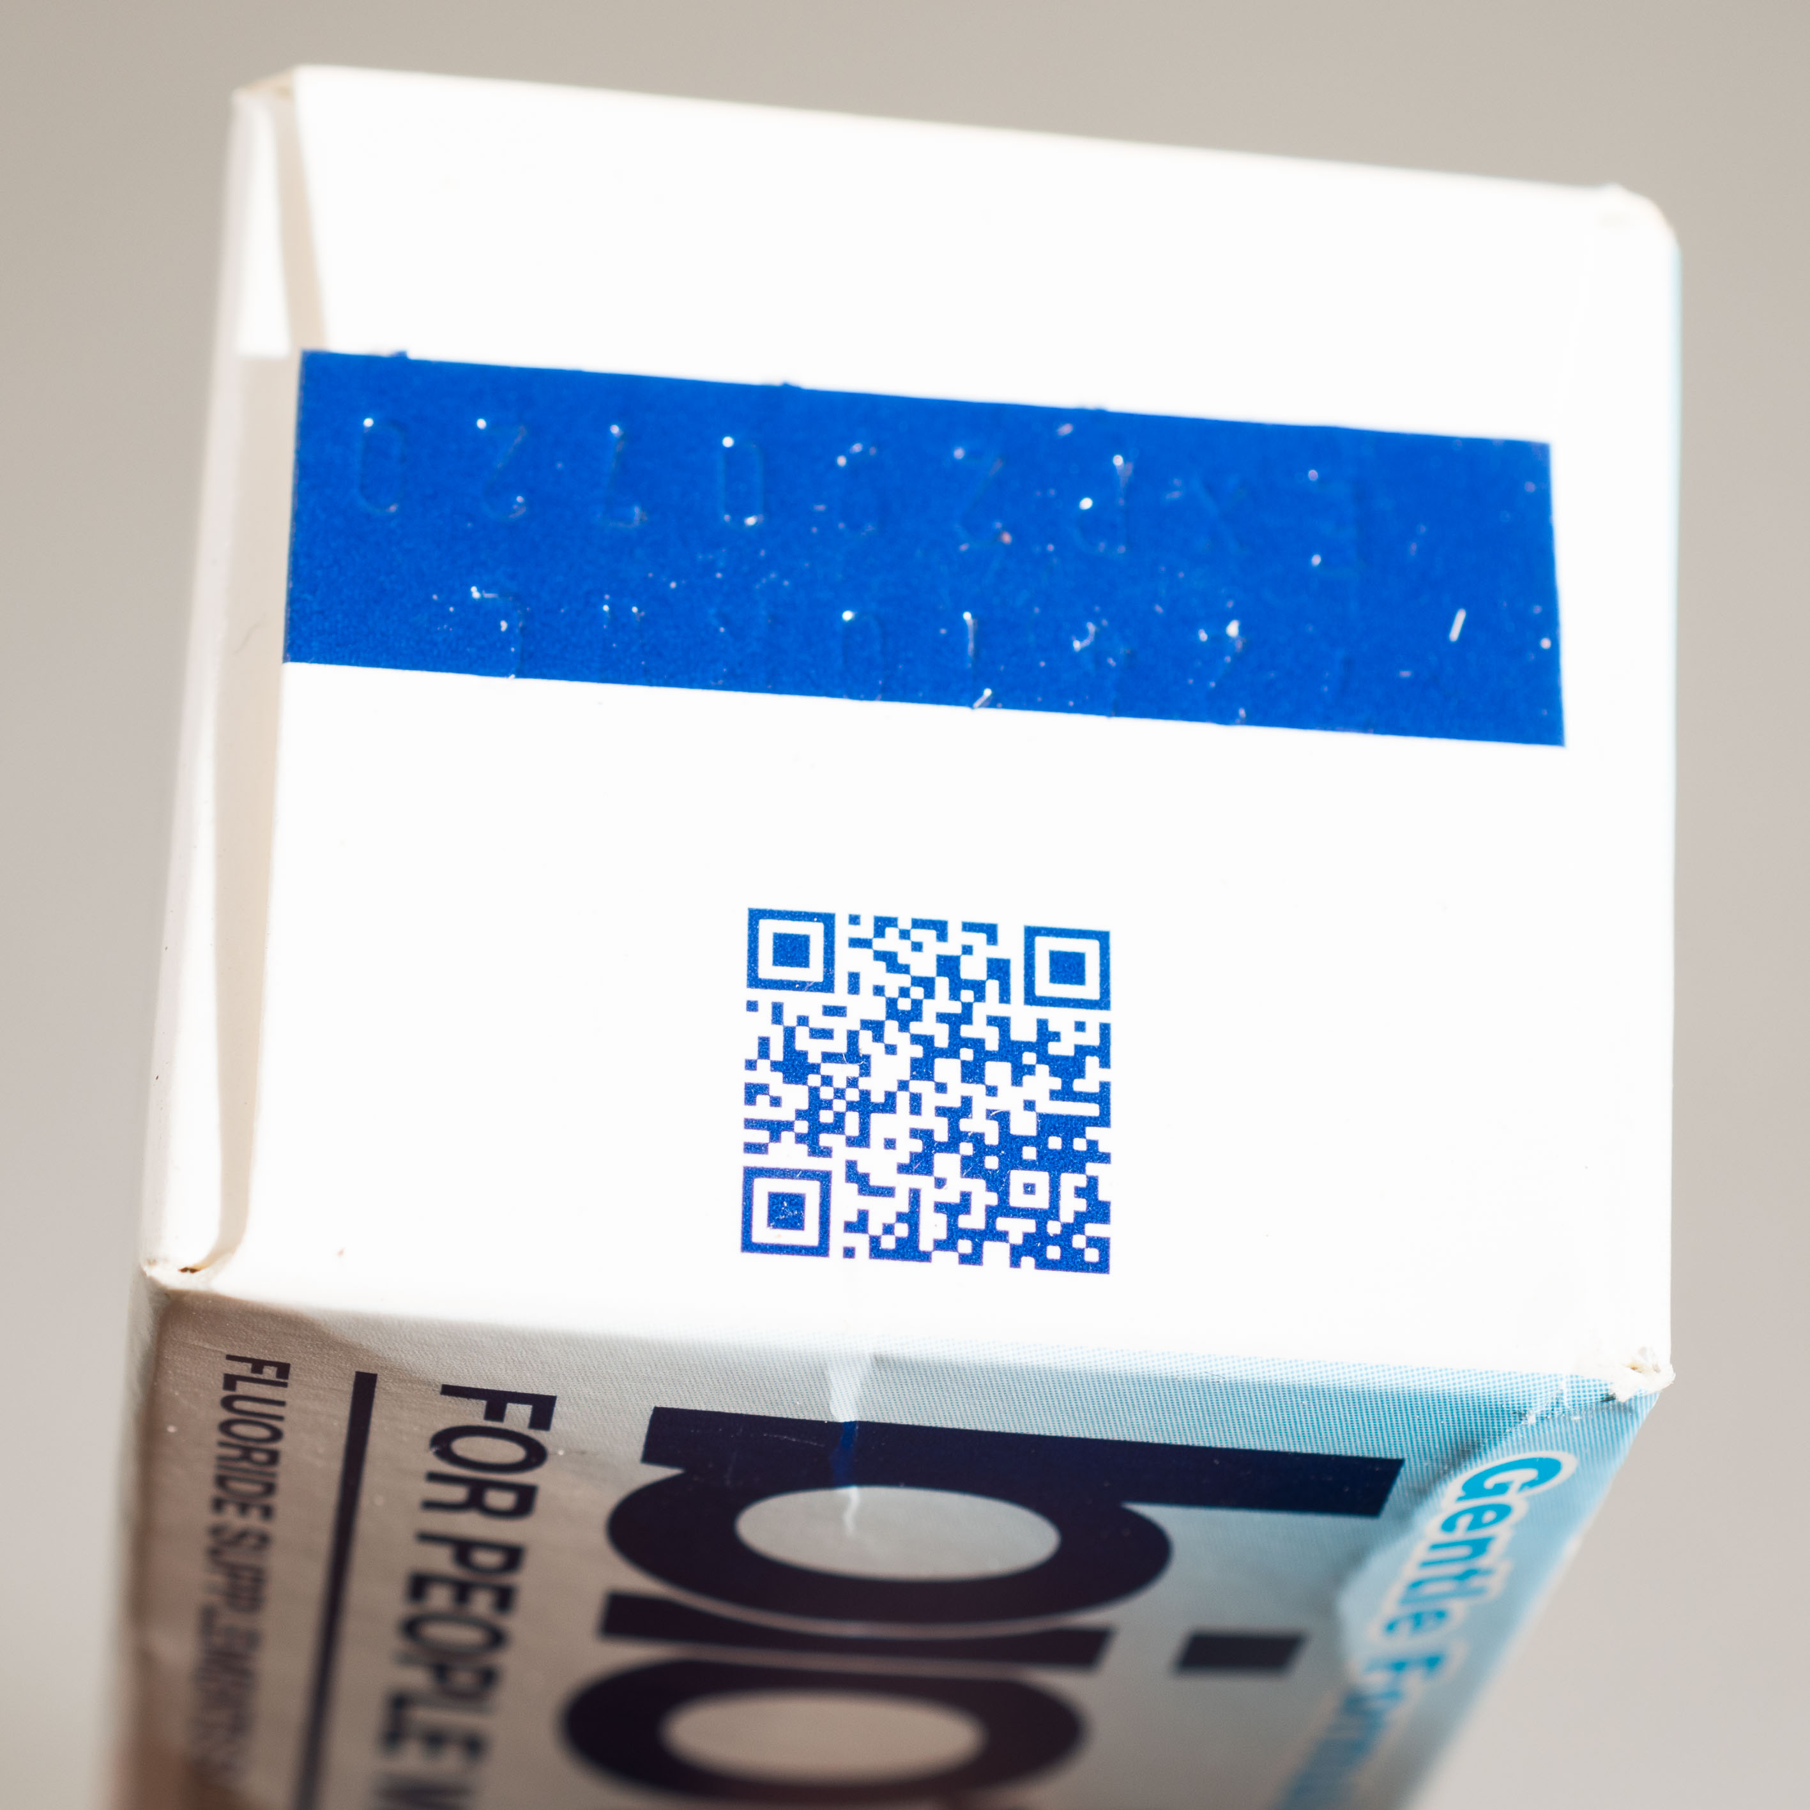
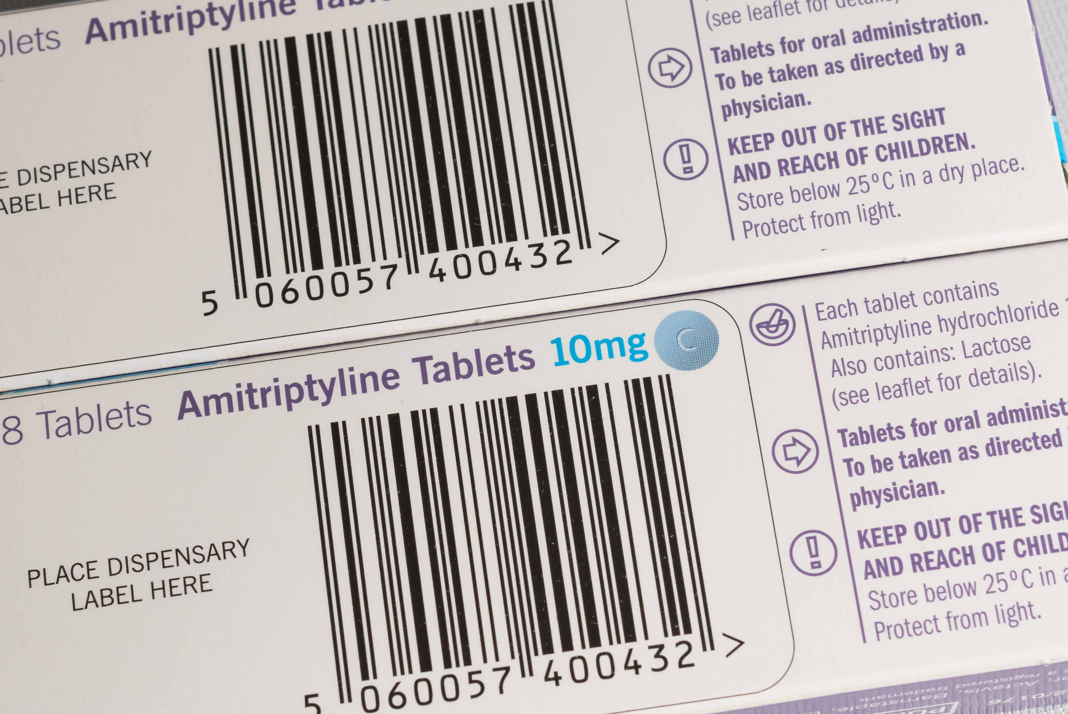
Other types of barcode (not FMD)
Linear barcode
[pre-printed]
QR code
[note three squares
in corners of code]

Slide 11
FMD error and alert messages

Slide 12
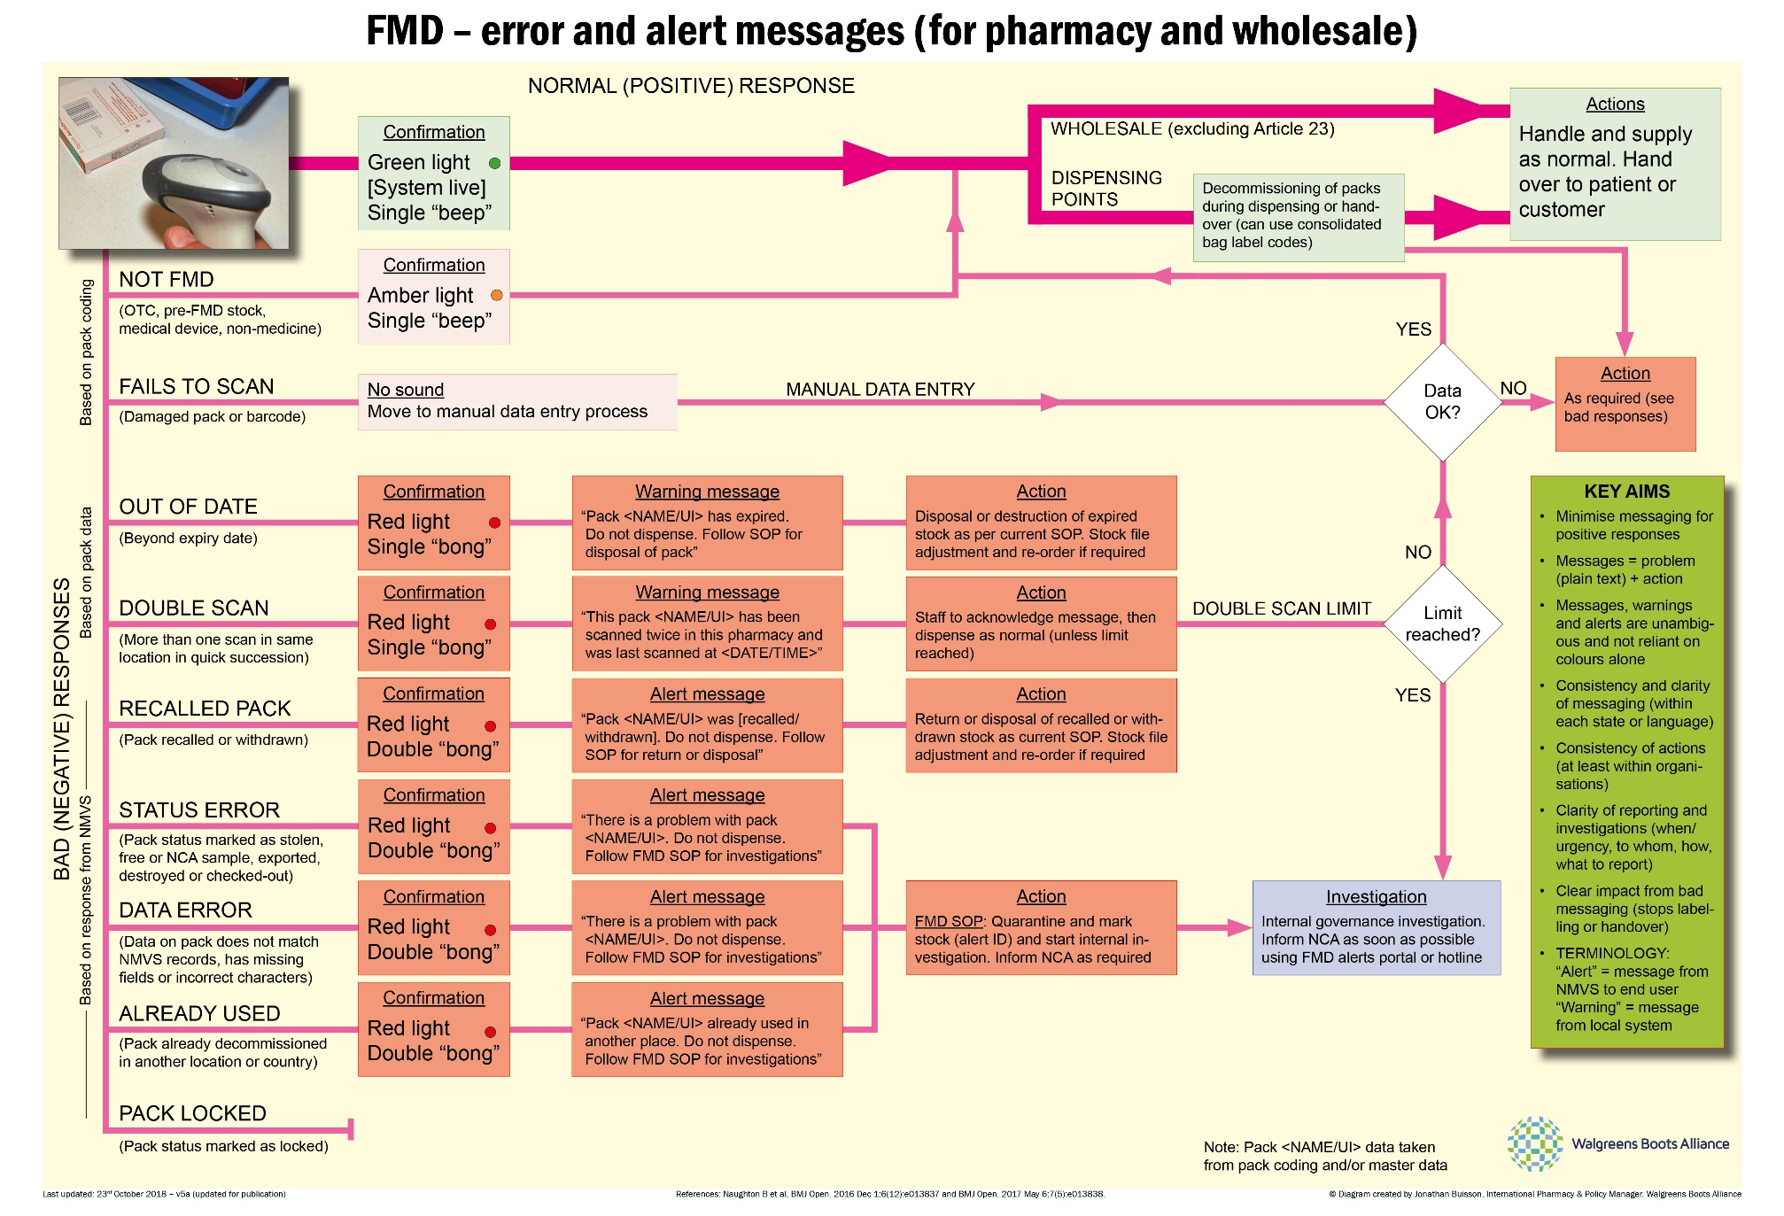
Notes:
Handling of FMD error messages, warning and alerts raised by local or national FMD systems. To be read alongside associated guidance notes (available via FMD Source)

Slide 13
The journey of a patient pack

Slide 14
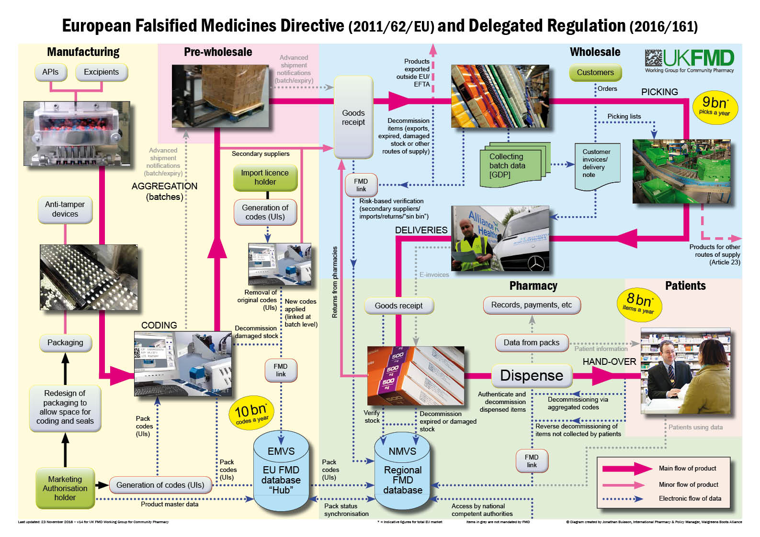
Notes:
The “FMD big chart” – our work has given us a detailed understanding of the main flow of products (pink lines) and where data will be exchanged between companies and with the central and national databases (blue dotted lines). There are some data exchanges (grey lines) that we anticipate will, might or could happen in future, but these are not mandated by the Directive.

Slide 15
For further details and updates:
Jonathan Buisson MFRPSII MRPharmS
FMD Communications Lead
UK FMD Working Group for Community Pharmacy
(jonathan.buisson@WBA.com)
Notes:
For any further information or updates, please contact Jonathan Buisson, FMD Communications Lead for UK FMD Working Group for Community Pharmacy

