Slide 1
This PSNC presentation can be used by LPCs and others at events on FMD organised for pharmacy contractors and their teams
Last updated 4th November 2018

Slide 2
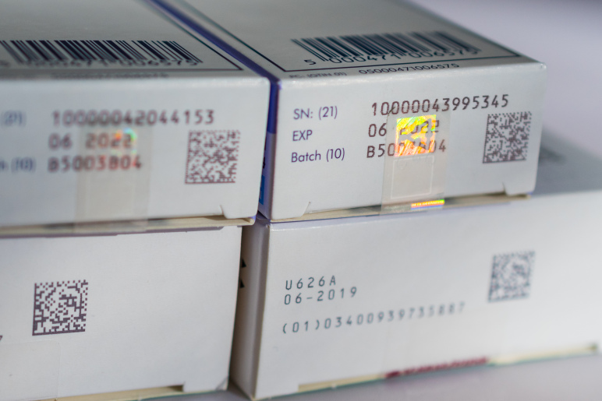
The Falsified Medicines Directive
What pharmacy teams need to do…

Slide 3
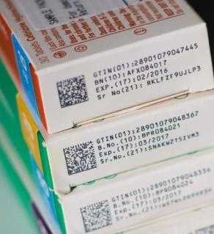
Overview
Explain the FMD requirements
How the authenticity of products will be checked
The implications of Brexit
The responsibilities of pharmacies and how it will work in practice
Funding issues
What contractors need to do now

Slide 4
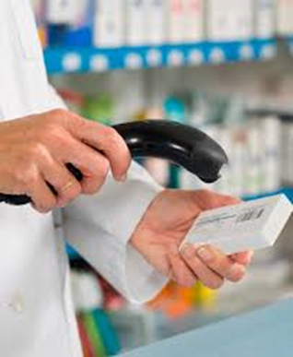
The Directive
“Safety features should allow verification of the authenticity and identification of individual packs, and provide evidence of tampering.”
Directive 2011/62/EU, Para 11

Slide 5
The Delegated Regulations
“Persons authorised or entitled to supply medicinal products to the public shall verify the safety features and decommission the unique identifier of any medicinal product bearing the safety features they supply to the public at the time of supplying it to the public.”
Delegated Regulation 2016/161, Article 25(1)
Implementation must be undertaken by
Saturday 9th February 2019

Slide 6

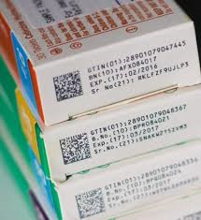
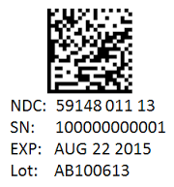
The two safety features
All packs of almost all prescription medicines* will have to have two safety features:
  Visual anti-tampering device
  Unique identifiers (serial numbers) plus product ID, expiry date and batch number in a 2D barcode
* homoeopathic products, radionuclides, gases, advanced cell therapies, intravenous products, specials are excluded. OTC omeprazole is included.

Slide 7
Checking authenticity…
Authenticity is checked in two ways:
  Visual inspection of the tamper-evident features
  Scanning and checking unique identifiers against databases at EU and national levels
Two actions to take when scanning a product…
  Verify – check whether the product is listed in the hub (can be done multiple times as and when required)
  Decommission – mark the product as supplied to a patient (or other end user)

Slide 8





Scanning and checking unique identifiers
Manufacturers (brands or generics)
Unique Identifiers
European Hub
Unique Identifiers
Parallel traders
UK hub
Other national system
Other national system
Other national system
Pharmacies
Wholesalers
Wholesalers
Pharmacies
Pharmacies
Wholesalers
Pharmacies
Wholesalers
Data uploads
Data exchange
Verification
Authentication
Notes:
The FMD concept is based around manufacturers and parallel traders uploading unique product identifiers which are then distributed to relevant national medicines verification systems by the European Hub. The unique identifiers can be used by wholesalers, pharmacies and other dispensing entities when they need to verify and authenticate (dispense) medicines in their possession. The European hub can be used to synchronise pack statuses across multiple markets and to verify products from other markets, if necessary.
[“Fluffy cloud diagram”]

Slide 9
FMD timeline for the UK
European Medicines Verification Organisation and European Hub established
Directive 2011/62/EU adopted
UK bodies participating in European discussions
Delegated Regulation
2016/161
published
2011
2014
2016
Appointment of Arvato as UK hub developer
FMD pilots start in UK
IT system upgrades
Full requirements of Directive start (scanning)
SecurMed UK established
2016
2017
2018
2019
2020
2021
FMD stock starts to appear
FMD onboarding
Majority of stock FMD compliant?
EU referendum
Brexit?
Notes:
Work on FMD has been going on in the background for a long time. UK pharmacy organisations have been involved with it at both a European level (through PGEU) and at a national level, through bodies like UK FMD Working Group and the FMD Implementation Advisory Board.
Until mid-2016, the UK was among the leading countries with FMD and was proceeding down the route of establishing its NMVO and then choosing a BSP. Not unsurprisingly, the EU referendum and the vote to leave the European Union has cast a long shadow over FMD (and much else) since then. A lack of clarity is affecting all sectors as time and attention is focused on Brexit activities.
SecurMed UK was formally established in July 2016, but the decision on appointing a BSP took much longer than expected and, so far, has only resulted in a Letter of Intent with Arvato, which has paved the way for establishing the UK NMVS.
This means that a lot of work that should have started in 2017 is now going to have to be compressed in to 2018 if the deadline of February 2019 is to be met. What happens after that is, as yet, unknown…

Slide 10
What about Brexit?
Brexit adds an extra layer of confusion and complexity
UK progress on implementation has been heavily delayed by discussions on Brexit and Government uncertainty on its implications
The Delegated Regulation will be incorporated into UK legislation under the EU (Withdrawal) Bill
Lack of clarity about what happens after Brexit and whether the UK will be “inside” FMD and connected to the European hub
Brexit?
Brexit?
Brexit?

Slide 11
What about Brexit?
Clear patient safety risks if UK is outside FMD
Expect a UK solution will be developed if we can’t access the European system
Contractors need to be conscious of the risks of the system needing to change post-Brexit when signing contracts for FMD systems
  be cautious about signing contracts with long terms
  ensure post-Brexit changes to FMD will be dealt with by the supplier
Brexit?
Brexit?
Brexit?

Slide 12
The FMD responsibilities of pharmacies
Verify the authenticity of products
  checking the anti-tampering device and unique identifiers and
  then decommission the unique identifiers at the time of supplying it to the public (this is not an instant, but a period of time)
Only be able to revert decommissioned products (recommission) within 10 days of the original decommissioning (the “10 day rule”)

Slide 13
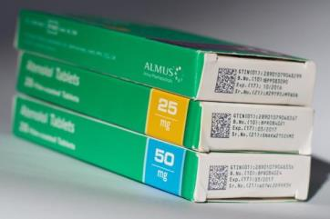
The FMD responsibilities of pharmacies
Not to supply decommissioned products (other than those they decommission themselves as part of dispensing)
  if a pack is decommissioned for a patient, but the item is not collected, the pack must be disposed of
  split packs – decommission when the first part of pack is supplied to the patient

Slide 14
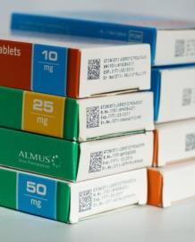
The FMD responsibilities of pharmacies
If technical problems prevent authentication, to record unique identifiers and then verify and decommission when possible
Decommission products that cannot be returned to wholesalers or manufacturers or which are taken as samples
Notify authorities of any suspected incidents of tampering or falsification

Slide 15

















How will it work in practice?
Manufacturer uploads pack data to hub
Optional verification scan
Optional verification scan
Manufacturer
Wholesaler
Delivery to pharmacy
Community Pharmacy
Prescription dispensed, items scanned and UI data cached
Prescription bagged and code printed on bag label
Patient arrives to collect prescription
Bag label code scanned and UIs for each pack are decommissioned
Patient receives prescription

Slide 16
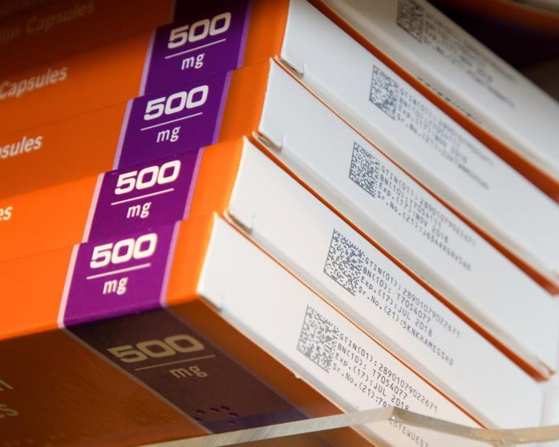
How will it work in practice?
Standalone systems are an option
  may be less complicated to implement in the early days (when less FMD compliant stock in pharmacies)
  possibly cheaper than integrated systems
Care homes / MDS – decommission at the point of deblistering
Deliveries – decommission when the driver/courier leaves the pharmacy
Be aware – some products are already serialised, but will not be in the FMD hub

Slide 17

Who pays for FMD?
Research -led manufacturers
Generics manufacturers
Parallel distributors
Wholesalers
Pharmacies
ABPI
BGMA
BAEPD
HDA
NPA/CCA
National Medicines Verification System
Manufacturers
Wholesalers
Pharmacies
Hospitals
GP surgeries
Notes:
The National Medicines Verification Organisation – NMVO – for the UK was established in July 2016 and is known as SecurMed UK. Its structures mirrors the EMVO and is an equal partnership between six British associations representing the five main sectors of the medicines supply chain:
ABPI representing the main “research-led” pharmaceutical companies producing innovative branded medicines
BGMA representing manufacturers of generic medicines
BAEPD representing parallel distributors trading across European markets under free movement rules
HDA representing full-line pharmaceutical wholesalers
NPA and CCA representing community pharmacies (or “dispensing entities) – the two organisations have a memorandum of understanding to jointly appoint a single director to represent them and to share costs
The NMVO is overseen by its Board of Directors (one for each sector) and the National Competent Authority, which in the case of the UK is the Department of Health and the UK’s medicines regulator, the MHRA.
SecurMed has signed a Letter of Intent to appoint Arvato Systems GmbH as the Blueprint Service Provider to set up and run the National Medicines Verification System (NMVS) for the UK. All pharmacies, wholesalers, hospitals and GP surgeries will have to connect to this in order to verify, authenticate and decommission the unique identifiers on packs of medicines, once FMD starts.

Slide 18
Funding for pharmacy contractors
“Each sector is responsible for its own costs for connecting to the system”
Each of the four national community pharmacy negotiators (PSNC, CPS, CPW and CPNI) is working to ensure that contractors’ FMD-related costs are recognised in future NHS funding settlements
Costs for contractors relate to:
  equipment, e.g. 2D scanners
  software purchase and maintenance
  additional workload related to FMD checks

Slide 19
What do contractors need to do now?
1) Read the guidance available at fmdsource.co.uk
2) Explore the system options – list of suppliers on FMD Source
  Integrated with PMR
  Standalone
3) Decide how you want to implement FMD and whether you will take a staged approach?
4) Select your supplier, contract with them and decide what hardware you need (additional terminals, power supplies, wireless scanners…)

Slide 20
What do contractors need to do now?
5) Register with SecurMed (“on-boarding”)
  pharmacies will have to individually register with SecurMed
  SecurMed will need to verify the identity of the pharmacy
6) Finalise the optimal way you will implement FMD in your pharmacy and then revise your SOPs
7) Develop your implementation plan and start to train your staff on FMD and the new processes which will be introduced

Slide 21
Enforcement and sanctions…
GPhC will enforce the requirements in community pharmacies
Sanctions
  DHSC and MHRA proposed in their recent consultation that a mixture of both criminal and civil sanctions be used to tackle non-compliance
  civil sanctions might include written warnings, stop notices and civil fines, before the application of criminal sanctions which would only be used for the most serious (intentionally fraudulent) breaches
  criminal sanctions – with a person liable on summary conviction to an unlimited fine or liable on conviction on indictment to a fine, or to imprisonment for a term not exceeding two years, or to both

Slide 22
Potential benefits of FMD
[Identification of falsified medicines]
Improved accuracy and date checking of items being dispensed – an end of look alike, sound alike (LASA) dispensing errors?
An impact on indemnity costs?
Easier management of stock recalls, potentially at patient level if Unique Identifier is stored in the PMR

Slide 23
Potential benefits of FMD
An opportunity to review the efficiency of the dispensing process?
Pharmacy stock benefits
  Accurate pack-level data for all products
  Automatic expiry date checking

Slide 24
Conclusion
There is a lot to do in a very short amount of time…
Many contractors may initially choose to adopt a “simple” approach to compliance
The additional benefits of FMD are likely to come from use of integrated systems once the majority of stock is FMD compliant
But that also requires contractors and their teams to think carefully about how they redesign dispensary workflows

Slide 25
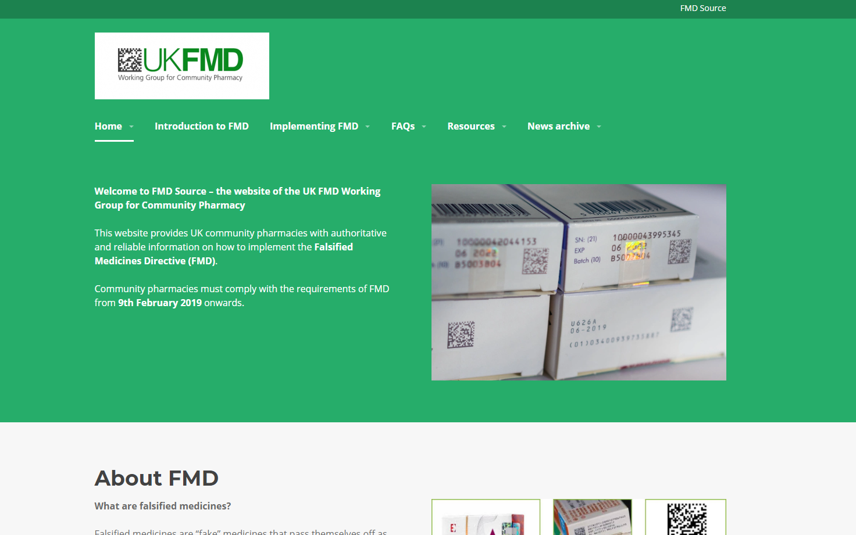

Questions
fmdsource.co.uk

