Slide 1
FMD progress update
Implementing the EU Falsified Medicines Directive in the UK
[NAME OF PRESENTER]
[TITLE OF PRESENTER]
[COMPANY NAME]
Notes:
A slide deck that sets out progress on implementing the EU Directive on Falsified Medicines [2011/62/EU] and Delegated Regulation [2016/161] in the UK [as at 7th December 2017]
CHANGE NAMES AND DATES AS REQUIRED

Slide 2
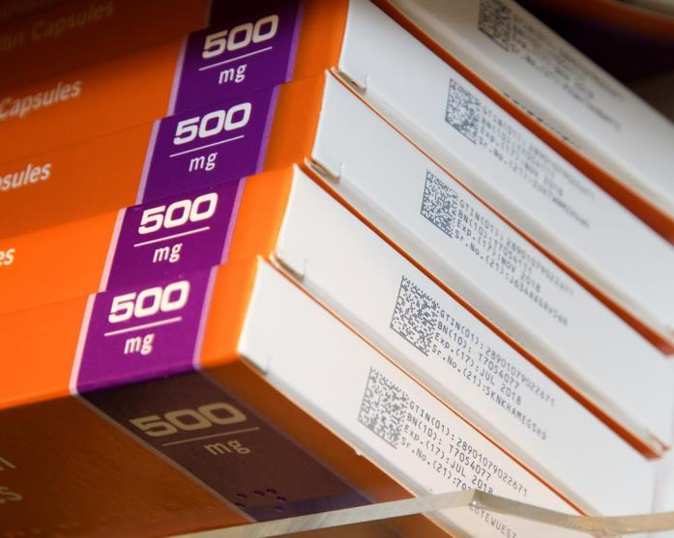
Notes:
The future is already here. These packs were found in Boots in Kingston-upon-Thames in March 2015. Many contract manufacturers are already moving towards using 2D barcodes, especially those based in India which is bringing in similar legislation requiring pack serialisation.
[These packs are not fully FMD-compliant yet. The serial numbers are not uploaded to the European hub and they do not have safety features]

Slide 3
FMD timeline and concept
Notes:
A brief recap on FMD timelines. These slides can be skipped if being shown alongside FMD Presentation (1) Introduction to FMD.

Slide 4
Falsified Medicines Directive (FMD) timeline
Directive 2011/62/EU adopted
First elements of Directive come in to force (APIs and excipients)
EMVO and European Hub established
EU logo for online pharmacies starts
2011
2013
2015
Delegated Regulation
2016/161
published
Set up NMVOs/
pick BSPs
Full requirements of Directive start (scanning)
End of non-2D packs (could be earlier)
FMD pilots
2016
2017
2018
2019
2024
FMD onboarding
Brexit?
Notes:
FMD is a very long running project. There was nearly a decade of discussions leading up to the formal adoption of Directive 2011/62/EU and it’ll have been more than a decade since then by the time that all medicines across Europe carry the required 2D data matrix and individual serial numbers. Scanning and verification of packs will start in early 2019 with pilot work prior to that.
Most EU/EEA countries, including the UK, have established an NMVO. Most of these have chosen their BSP (with the majority choosing Arvato) and started setting up their NMVSs. The most advanced countries, including Ireland, Germany and Sweden, are planning to start pilot phases with pharmacies and wholesalers early in 2018.

Slide 5

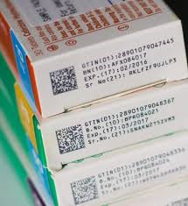
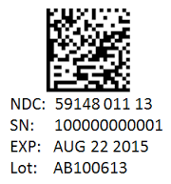
FMD and safety features
Anti-tampering device
Safety features
Unique Identifier
“Medicinal products subject to prescription shall bear safety features on their packaging”
FMD Delegated Regulation 2016/161, Article 2
Notes:
The FMD Delegated Regulation sets clear requirements for the 2D data matrix and accompanying information – based on widely used ISO standards – but there is much less guidance on anti-tamper devices.
The nature of the anti-tamper device will vary according to the product and the packaging it is contained in. Common examples are:
Packs that have ends glued shut
Use of seals or tear-off strips over pack closures
Shrink-wraps over packs and bottle necks
Closures or caps that have to be broken to open packs or bottles
Foil-packed products
As a result, checking the anti-tamper seal is always likely to be a manual process requiring a visual inspection.

Slide 6
FMD concept for verification
Unique Identifiers
Unique Identifiers
Manufacturers (brands or generics)
European Hub
Parallel traders
National system
National system
National system
National system
Pharmacies
Wholesalers
Wholesalers
Pharmacies
Pharmacies
Wholesalers
Pharmacies
Wholesalers
Data uploads
Data exchange
Verification
Authentication
Notes:
The FMD concept is based around manufacturers and parallel traders uploading unique product identifiers which are then distributed to relevant national medicines verification systems by the European Hub. The unique identifiers can be used by wholesalers, pharmacies and other dispensing entities when they need to verify and authenticate (dispense) medicines in their possession. The European hub can be used to synchronise pack statuses across multiple markets and to verify products from other markets, if necessary.
[“Fluffy cloud diagram”]

Slide 7
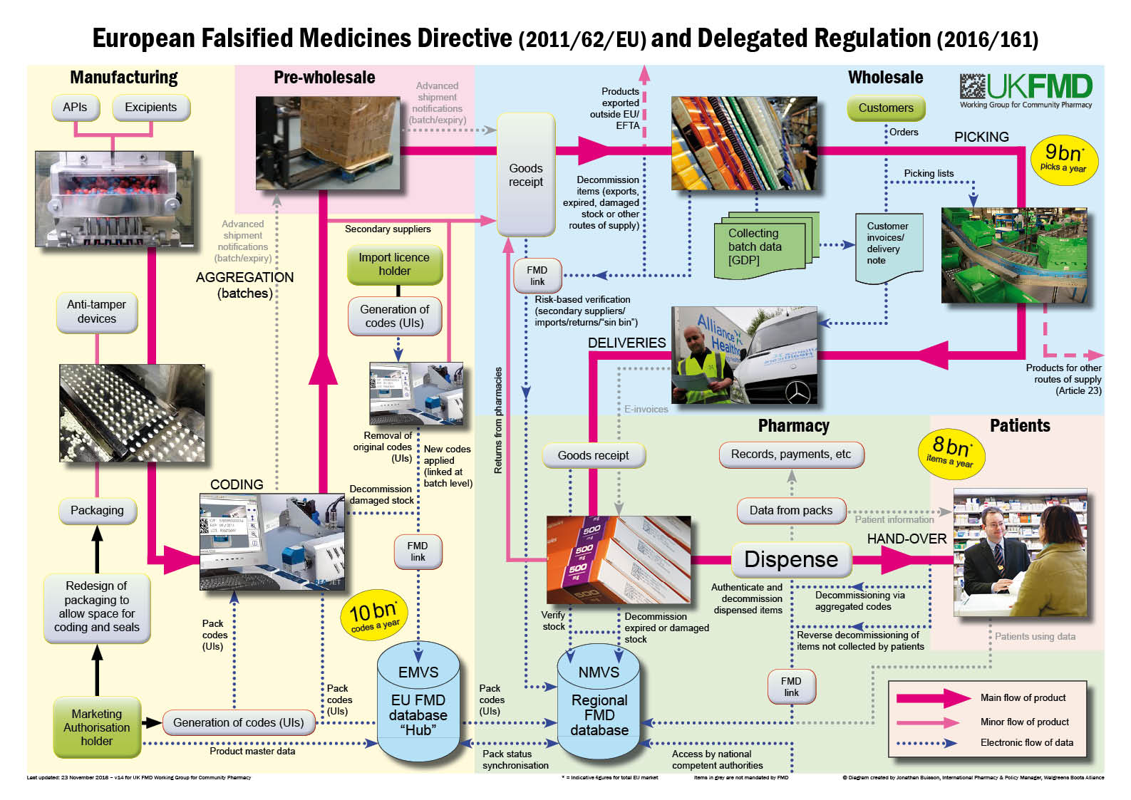
Notes:
Forget the “fluffy clouds” – this gives a more realistic view of the complexity of the medicines supply chain – reality is much, much more complex than this!
The “FMD big chart” – our work has given us a detailed understanding of the main flow of products (pink lines) and where data will be exchanged between companies and with the central and national databases (blue dotted lines). There are some data exchanges (grey lines) that we anticipate will, might or could happen in future, but these are not mandated by the Directive.

Slide 8
FMD implementation – key players

Slide 9







European Stakeholder Model and EMVO
Research -led manufacturers
Generics manufacturers
Parallel distributors
Wholesalers
Pharmacies
NMVO
NMVO
NMVO
NMVO
NMVO
Notes:
The European Medicines Verification Organisation – EMVO (represented here by the “Space Invader” logo) – was formed out of a earlier collaboration known as the European Stakeholder Model (ESM) as an equal partnership between the five European associations representing the five main sectors of the medicines supply chain:
EFPIA representing the main “research-led” pharmaceutical companies producing innovative branded medicines
Medicines for Europe (formerly EGMA) representing manufacturers of generic medicines
EAEPC representing parallel distributors trading across European markets under free movement rules
GIRP representing full-line pharmaceutical wholesalers
PGEU representing community pharmacies
The EMVO has set up the European Medicines Verification System (or “European Hub”) and provides support to the emerging National Medicines Verification Organisations (NVMOs) as they are set up. The EMVO provides guidance to the NMVOs in the form of User Requirement Specifications (URS) for the development of National Medicines Verification Systems (NMVSs), draft Memorandums of Understanding and ongoing monitoring and support.
EMVO developed the “Blueprint Service Provider” model through which three large IT service companies pre-qualified to provide standardised national verification systems that will meet the User Requirement Specifications. Each national organisation can then hold a competitive tender between the three companies – Aegate, Avarto, and Solidsoft Reply – and (if they wish) any local providers. This is designed to ensure standardisation of systems that will need to be interconnected (via the European Hub) while retaining a degree of competition to drive down prices.
Under the Delegated Regulation, the three “manufacturer” groups (research-led, generics and parallel distributors) will have to pay for the operation of the European Hub and the relevant national systems (jointly known as the “repositories”) while participating wholesaler and pharmacy organisations pay a share of the governance costs in return for appointing voting directors to the boards of the organisations.

Slide 10

SecurMed UK – the UK’s NMVO
Research -led manufacturers
Generics manufacturers
Parallel distributors
Wholesalers
Pharmacies
ABPI
BGMA
BAEPD
HDA
NPA/CCA
National Medicines Verification System
Manufacturers
Wholesalers
Pharmacies
Hospitals
GP surgeries
Notes:
The National Medicines Verification Organisation – NMVO – for the UK was established in July 2016 and is known as SecurMed UK. Its structures mirrors the EMVO and is an equal partnership between six British associations representing the five main sectors of the medicines supply chain:
ABPI representing the main “research-led” pharmaceutical companies producing innovative branded medicines
BGMA representing manufacturers of generic medicines
BAEPD representing parallel distributors trading across European markets under free movement rules
HDA representing full-line pharmaceutical wholesalers
NPA and CCA representing community pharmacies (or “dispensing entities) – the two organisations have a memorandum of understanding to jointly appoint a single director to represent them and to share costs
The NMVO is overseen by its Board of Directors (one for each sector) and the National Competent Authority, which in the case of the UK is the Department of Health and the UK’s medicines regulator, the MHRA.
SecurMed has signed a Letter of Intent to appoint Arvato Systems GmbH as the Blueprint Service Provider to set up and run the National Medicines Verification System (NMVS) for the UK. All pharmacies, wholesalers, hospitals and GP surgeries will have to connect to this in order to verify, authenticate and decommission the unique identifiers on packs of medicines, once FMD starts.

Slide 11

UK FMD Working Group for Community Pharmacy
Pharmacy contractor associations
Pharmacy negotiating bodies
NPA
AIM
CCA
PSNC
CPNI
CPS
CPW
Representing contractors’ interests to DH/MHRA
Process mapping and options development
Establishing FMD Source as trusted FMD resource
Bringing suppliers and IT providers together
Notes:
The UK FMD Working Group for Community Pharmacy was formed to ensure that community pharmacy contractors’ interests are represented to the Department of Health and MHRA and that the complexity of dispensing processes in the UK are fully understood and taken in to account when FMD is being implemented.
It has to be said that FMD follows a rather generic “European” model – it is assumed that medicines pass simply from factory to wholesaler to pharmacy and then to patients. While this is broadly true, we know that in reality it is much more complex and, certainly in the UK, most medicines are not dispensed directly in front of patients at the time they are supplied. There are endless complexities, such as repeat dispensing, monitored dosage systems and emerging hub-and-spoke models, that will need to be accommodated if the whole supply chain is not to grind to a halt, inconveniencing patients.
Most medicines supplied in the UK are dispensed on the NHS. Any “retail” transactions, like checking eligibility or exemption status and paying prescription charges (in England), often takes place when the prescription is received and medicines are normally handed over in a pre-prepared dispensing bag rather than being individually scanned or priced in front of the patient.
The Working Group meets regularly with DH/MHRA and has organised visits for officials to pharmacies so that they can understand the potential impacts to what is already a very busy and highly efficient system.
We have also set up FMD Source as an authoritative source of information about FMD and its implementation. FMD Source will be continually updated as we move towards implementation.

Slide 12
FMD Implementation Advisory Board
Health Ministers
FMD Implementation Ministerial Advisory Board
Pharmacy
Wholesale
Ambulances
Private hospitals
NHS Digital
Prisons
NHS Trusts
Manufacturers
Devolved Administrations
Distributors
Other healthcare
GPs
SecurMed UK
Established by DH/MHRA to advise Health Ministers
Brings together all those involved with implmenting FMD
Many working groups established
Leading to Impact Assessment and formal consultation
Notes:
The DH and MHRA have established a Ministerial Advisory Board on implementing FMD. It first met in March 2016 and has met at roughly quarterly intervals since then with an ever-growing attendance list. This forms the most official line of communication with DH and, in theory, provides advice that will guide Health Ministers in making final decisions around FMD.
Community pharmacy has been represented on the Board from the beginning through trade bodies and negotiators. The meetings bring together the whole spectrum of organisations which handle medicines (to a greater or lesser extent) as part of their day-to-day operations.

Slide 13
Implementing FMD – what happens next?

Slide 14
FMD timeline for the UK
Directive 2011/62/EU adopted
UK bodies participating in ESM discussions
EMVO and European Hub established
Delegated Regulation
2016/161
published
2011
2014
2016
UK BSP decision
FMD pilots start in UK
IT system upgrades
Full requirements of Directive start (scanning)
SecurMed UK established
DH/MHRA
consultation
2016
2017
2018
2019
EU referendum
FMD stock starts to appear
All parties connected to NMVS
Brexit?
Notes:
Work on FMD has been going on in the background for a long time. UK pharmacy organisations have been involved with it at both a European level (through PGEU) and at a national level, through bodies like UK FMD Working Group and the FMD Implementation Advisory Board.
Until mid-2016, the UK was among the leading countries with FMD and was proceeding down the route of establishing its NMVO and then choosing a BSP. Not unsurprisingly, the EU referendum and the vote to leave the European Union has cast a long shadow over FMD (and much else) since then. A lack of clarity is affecting all sectors as time and attention is focused on Brexit activities.
SecurMed UK was formally established in July 2016, but the decision on appointing a BSP took much longer than expected and, so far, has only resulted in a Letter of Intent with Arvato, which has paved the way for establishing the UK NMVS. A full contract to develop the NMVS has yet to be agreed.
At the same time, a long-awaited consultation on FMD “flexibilities” (see next slide) and an accompanying impact assessment on the costs of FMD, due to be run by the Department of Health and MHRA, has been repeatedly delayed and is now not expected until early 2018. This will look at some elements of FMD, not its overall implementation.
This means that a lot of work that should have started in 2017 is now going to have to be compressed in to 2018 if the deadline of February 2019 is to be met. What happens after that is, as yet, unknown…

Slide 15
What about Brexit?
The UK’s decision to leave the European Union adds an extra layer of confusion and complexity
In theory, the Delegated Regulation will be incorporated in to UK legislation under EU (Withdrawal) Bill
UK progress on implementation has been heavily delayed
Lack of clarity about what happens afterwards and whether UK would “inside” FMD and connected to EMVS (Note: Switzerland is/will be)
Clear patient safety risks if UK is outside FMD
Notes:
There’s no doubt that the decision to leave the European Union has thrown a spanner in to the (FMD) works in the UK. Although the Department of Health has reiterated that implementing FMD is “business as usual”. With the start date (in February 2019) being ahead of the expected Brexit day (end of March 2019), the Delegated Regulation would form part of the existing EU legislation to be incorporated in to UK legislation under the provisions of the EU (Withdrawal) Bill – formerly known as the Great Repeal Bill.
However, a lack of clarity has probably been the defining feature of the current Government’s approach to Brexit and FMD is no different. Delays to consultations and decision making have pushed scheduled timetable well behind schedule.
Moreover, while the implementation timetable looks challenging, it is the lack of certainty about what happens after Brexit that is causing most concern. A comprehensive Free Trade Agreement with a high degree of regulatory alignment, which might well be expected for pharmaceuticals, may see the UK remain connected to the European hub (EMVS) – Switzerland offers an example of this – but this is a long way off being settled.
Pack serialisation – which is at the heart of FMD – is a global approach to addressing falsified medicines. Manufacturers will be changing production lines for the rest of Europe and serialised stock is likely to become the norm in the UK in any case. There are clear risks if the UK becomes the “hole in the polo mint” in terms of authentication of medicines.
Clearly there is some way to go on this and the UK situation remains volatile. Watch this space…

Slide 16
FMD “flexibilities”
Medicines supply chains vary across Europe. The Delegated Regulation gives Member States some “flexibilities” for this
Coding Use of national remuneration numbers and inclusion of additional patient information in UIs
Decommissioning Allowing wholesalers to undertake decommissioning for “Article 23” groups who supply medicines on irregular or infrequent basis
Supervision Oversight of National Medicines Verification Organisation
Notes:
Because there are some quite wide variations in the routes that medicines can take to reach patients, and the differing systems used for payment and reimbursement, across Europe, the Delegated Regulation includes some “flexibilities” that Member States can implement through their own national legislation, within the wider envelope of European regulations.
There are two flexibilities around what information is included in the 2D data matrix (barcodes) that will appear on packs:
Whether a national remuneration number is included alongside the information on product, serial number, batch and expiry
Whether additional patient information (probably in the form of a link to manufacturer’s website) is included
In practice, neither of these is expected (to start with) in packs aimed at the UK market. There is (currently) no UK-wide national reimbursement number, so this flexibility is not being used, and adding additional information increases the size of the 2D code, which can make printing more difficult or expensive. Such links are likely to be included in other way, such as QR codes that are mass-printed on to packs
Decommissioning by wholesalers under the so-called “Article 23” route is one of the main areas of discussion. Obviously, for wholesalers, this represents a new way of working with the potential for additional cost and time delays. Contrary to some statements, wholesalers will not be decommissioning for community pharmacies – pharmacies are specifically excluded from Article 23 and will have to do their own decommissioning. This is aimed at smaller groups like armed forces, rescue teams or research units that use medicines more infrequently, or in situations where making a connection to the NMVS would be impractical or might introduce delay. The full range of groups to be include is yet to be finalised.
The Department of Health and MHRA act as the National Competent Authority for the UK and attend meetings of SecurMed UK as observers as part of their supervision role.
DH and MHRA have been planning to hold a formal consultation on these flexibilities. This has been repeatedly delayed and is now expected early in 2018.

Slide 17
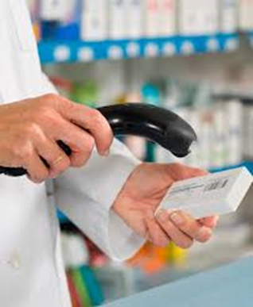
FMD – emerging key issues for pharmacies
Authentication “at the time of supply”
10-day rule for reversing decommissioning
Updating internal IT systems and processes
Visibility of pharmacy data under FMD
Variable models of dispensing
Dealing with FMD incidents
Notes:
These are some of the key issues that will need to be addressed and settled as we work towards implementing FMD.
At the time of supply The Delegated Regulation says that products have to be authenticated and decommissioned “at the time of supply to the patient”. In the UK (and indeed other EU countries) we expect that for practical reasons it would be better if decommissioning took place as part of the normal process for assembling and labelling medicines, especially for the many medicines being dispensed in advance through managed repeats or for nursing homes, etc. This also avoids potentially time-consuming and difficult conversations with patients should, for some reason, a product fail its authentication check.
10-day rule There is a catch to undertaking decommissioning during assembly and labelling. Once a product has been marked as “Decommissioned” and had its status changed to “Inactive” on the NMVS, this process can only be reversed under certain conditions – the reversal has to happen in the same location (pharmacy) as the original decommissioning, and it must take place within 10 days of the decommissioning (hence the “10-day rule”). This means that uncollected stock cannot be left for long periods without checking or reversing the decommissioning. Pharmacy organisations are looking at ways in which the 10-day rule can be incorporated without causing major problems or leading to lots of perfectly good medicines being written off.
Pharmacy data The process of scanning “every pack, every time” for FMD authentication during dispensing will generate vast quantities of data, down to the level of individual packs. We need to ensure that the data we generate (which is legally “our data”) is protected and is used in ways that benefit pharmacies and their patients
Processes and incidents FMD will mean new processes to be followed by everyone in the medicines supply chain. We need to start thinking about how these will be updated and how they will be accommodated within physical and electronic systems. In addition, things will always go wrong and there will be an unknown number of incidents where medicines fail to authenticate for one reason or another. Processes for dealing with these, including reporting possible falsifications, will have to be set up.

Slide 18
Summary FMD readiness checklist for pharmacies
What needs doing? | Why? | Who is involved? | Done?
Software upgrades for pharmacy systems | FMD compliance and interface with EMVS/NMVS | Software suppliers | Work started
New scanners | 2D-capability and spares needed | Hardware suppliers | Still to do
Internet connection upgrades | Suitable bandwidth to manage data traffic | Telecoms suppliers | Still to do
Updated operating procedures | Staff readiness for FMD and compliance with professional standards | Pharmacists and pharmacy teams | Still to do
Managing FMD incidents | Readiness for negative scans and how to respond | Pharmacists and pharmacy teams | Still to do
FMD information for patients and customers | Reassurance on quality and standards | Pharmacists and pharmacy teams | Still to do
Notes:
Here’s just a few of the things that pharmacy owners and pharmacy teams will need to get to grips with over the next year or so.
Arvato has started to work with the main IT suppliers, giving them access to software development kits and test-beds.

Slide 19
Implementing FMD – what needs to happen?
National Medicines Verification System to be set up
Pilot verification systems in pharmacies, wholesalers, hospitals
Integrate FMD verification software with existing systems
Upgrade hardware (scanners) and IT connections
Develop processes for authentication in day-to-day practice
Develop procedures to deal with offline and “fail to authenticate”
Establish governance, inspection and enforcement rules
Explain to all in supply chain why, what and when of FMD
Explain to public and media why, what and when
Go live (2019) then iterate/develop
… and lots, lots more
Notes:
Lots to do and not that much time to do it, for a major IT-based project that will become business-critical for the entire medicines supply chain

Slide 20

Implementing FMD – time for action is now
The clock is already ticking!
Notes:
FMD will have to be implemented by February 2019, which means everyone will have to be largely ready for it before the Christmas rush starts at the end of 2018.
The time for talking is coming to an end – the time for action is now

Slide 21
Questions and discussion

Slide 22
For further details and updates:
Jonathan Buisson MFRPSII MRPharmS
FMD Communications Lead
UK FMD Working Group for Community Pharmacy
(jonathan.buisson@wba.com)
Notes:
For any further information or updates, please contact Jonathan Buisson, FMD Communications Lead for UK FMD Working Group for Community Pharmacy

